Slide 1
Networking
Ramachandran & Leahy Chapter 13

Slide 2
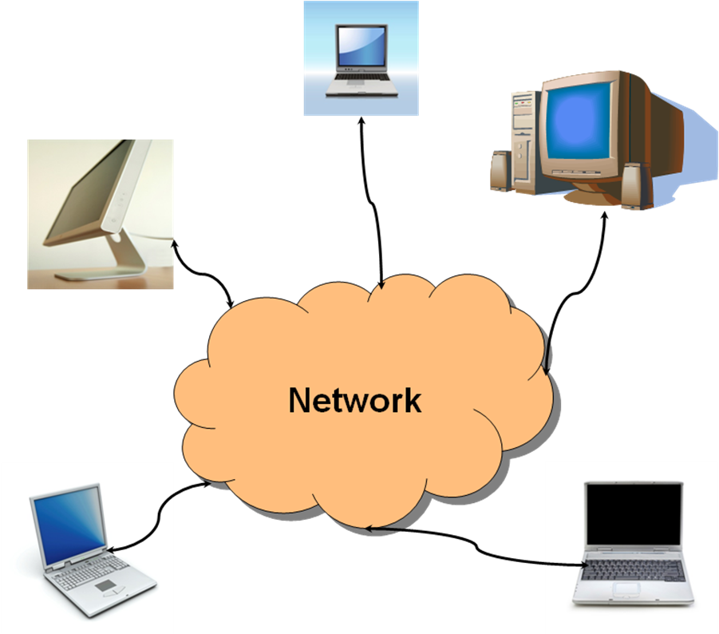
What do you mean by network?
A computer connected to a network is called a host
The connection is made using a device called a Network Interface Card or NIC
What exactly is “the network"?
It's a big collection of interconnected networks that all use the same protocols to communicate, hence "the internet"

Slide 3
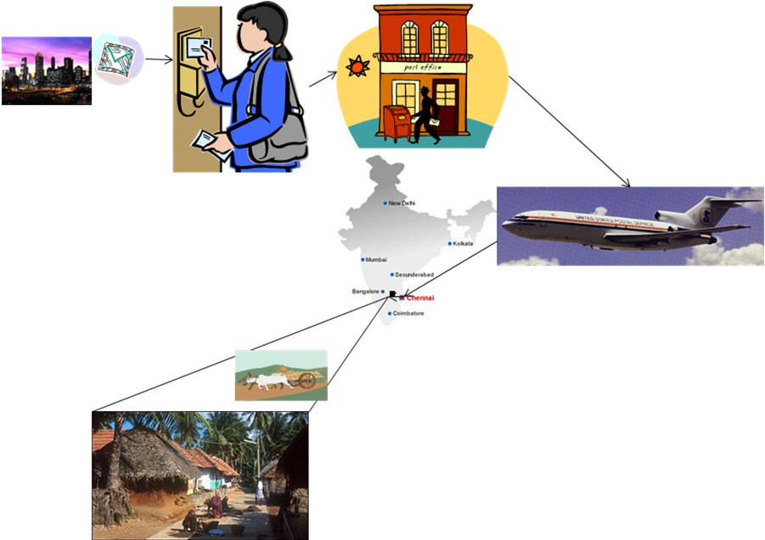
The traditional way
What is the Internet? Consider the postal system…
Chandra sends a birthday letter to her grandmother
Atlanta
Chennai, India
Mailpattie, Tamil Nadu

Slide 4
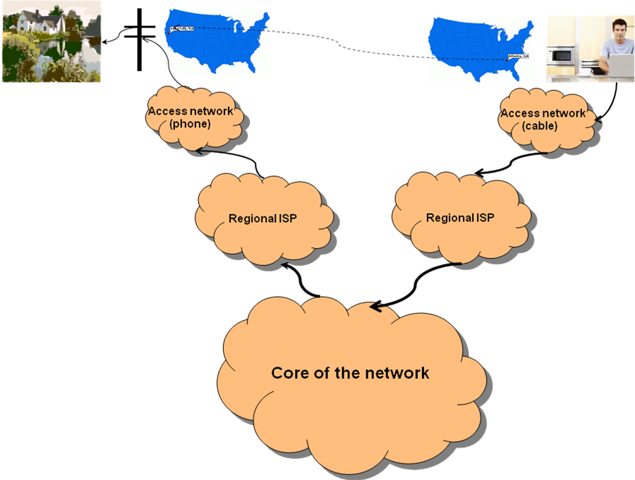
The modern way
Now consider an email from Joe to his grandmother
Yuba City, CA
Atlanta
Sacramento
Atlanta

Slide 5
Commonality
What do those two paradigms have in common?
Universally understood addresses!
A country and a postal code
The staff at the Atlanta regional post office probably have no idea where Mailpatti, Tamil Nadu, India is.
But they know how to get mail to India and specifically to deliver mail for the postal code for the state of Tamil Nadu via its capital Chennai
Once the mail gets to Chennai, the staff there know how to get it to Mailpatti, even if it must take a bullock cart
An IP address
The routers at the ISP in Atlanta probably have no idea where Yuba City, CA is, but they know how to get packets to the internet core
The internet core does know which ISP services the IP addresses in Yuba City, CA
The message goes to a mail server at the ISP and waits for Alex's grandmother to dial up her internet connection
Key point
No individual has to know where all the addresses are located, but at each hop they know where to forward an item to get it a hop closer

Slide 6
IP network connections
P1
P2
User
User
msg
msg
OS
OS
Protocol
stack
Protocol
stack
pkt1
pkt2
…
pktn
pkt1
pkt2
…
pktn
hdr
payload
Network
Big deal: Note that the Protocol Stacks are in the hosts, not in the middle of the Network

Slide 7
Contrast: Datagram or VC network
Internet (Datagram)
data exchange among computers
“elastic” service, no strict timing req.
many link types
different characteristics
uniform service difficult
“smart” end systems (computers)
can adapt, perform control, error recovery
simplicity inside network layer, complexity at “edge”
ATM (Virtual Circuits)
evolved from telephony
human conversation:
strict timing, reliability requirements
need for guaranteed service
“dumb” end systems
telephones
complexity inside network layer, simplicity at edge

Slide 8
Why does IP need a protocol stack?
Arbitrary message sizes
Out of order delivery
Packet loss
Bit errors
Queuing delays

Slide 9
Internet Protocol Stack
Application
Layer 5
Transport
Layer 4
Network
Layer 3
Link
Layer 2
Physical
Layer 1

Slide 10
The OSI Model
The OSI model is like the relational database model: It's great for studying networks, but has had very poor performance in real life
OSI Model
Data
Layer
Application
7
Data
Application
Network Process to Application
We'll start here
6
Data
Presentation
Data Representation
and Encryption
Transport
5
Data
Session
Interhost Communication
TCP/UDP
4
Segments
Transport
End-to-End Connections
and Reliability
3
Packets
Network
Path Determination
and IP (Logical Addressing)
IP
ARP
2
Frames
Data Link
MAC and LLC
(Physical addressing)
Ethernet
1
Bits
Physical
Media, Signal, and
Binary Transmission
1000baseSX

Slide 11
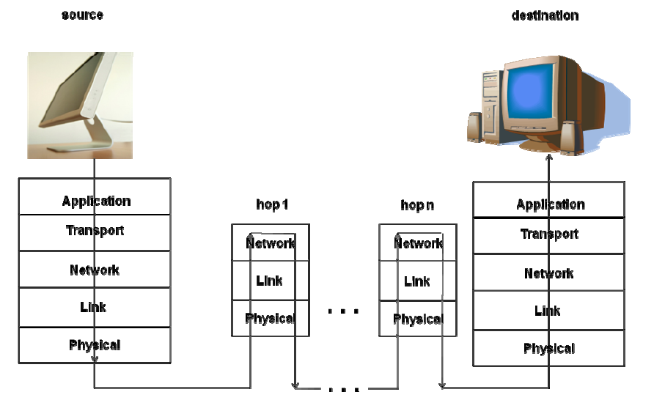
Getting from here to there…

Slide 12
Transport (session) protocol
We’re going to talk about these protocol types
Stop and wait
Pipelined transmission
Reliable pipelined transmission

Slide 13
Who invented the Internet?
Famous scientist, but think Manhattan project
All politicians, but they did provide money so give 'em a little credit
Packet switched networking, 1965
Devised IP suite to unify various networks, 1973
Vannevar Bush
George W. Bush
George H. W. Bush
Al Gore
J. C. R. Licklider
Robert Kahn & Vinton Cerf

Slide 14
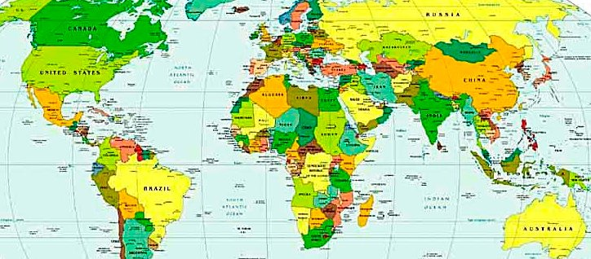
Stop and wait (for ack)
Pkt0
ACK0
Pkt1
ACK1
Pkt2
ACK2
Pkt3
. . .
2τ
2τ
2τ
Timeline of sender

Slide 15
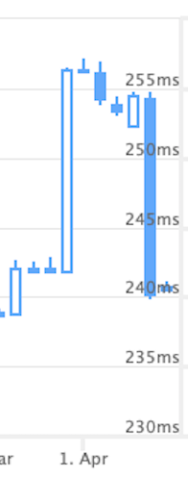
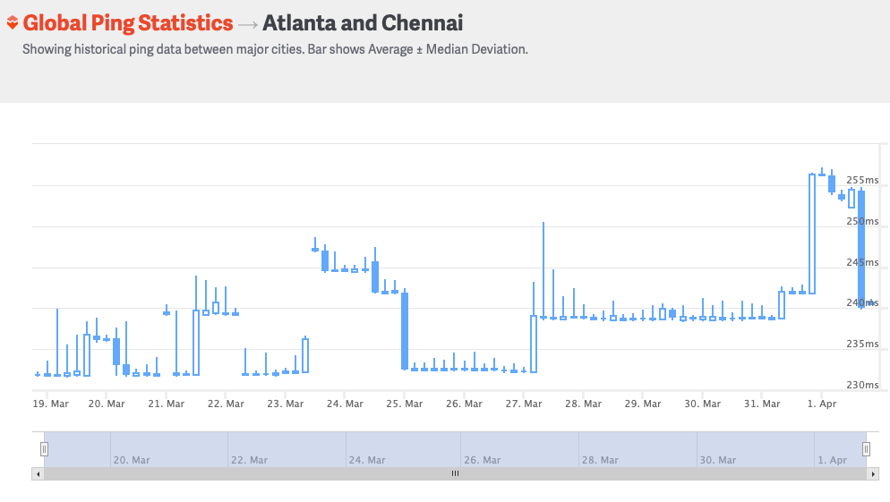
Latency

Slide 16
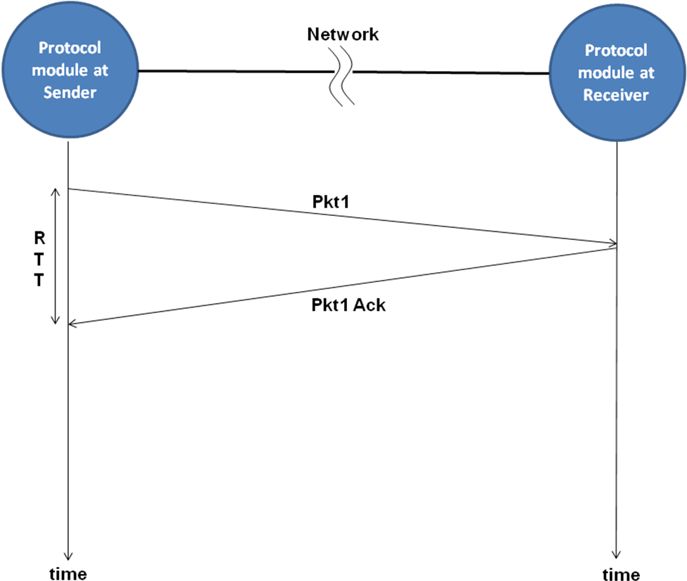
One round trip
Round Trip Time

Slide 17
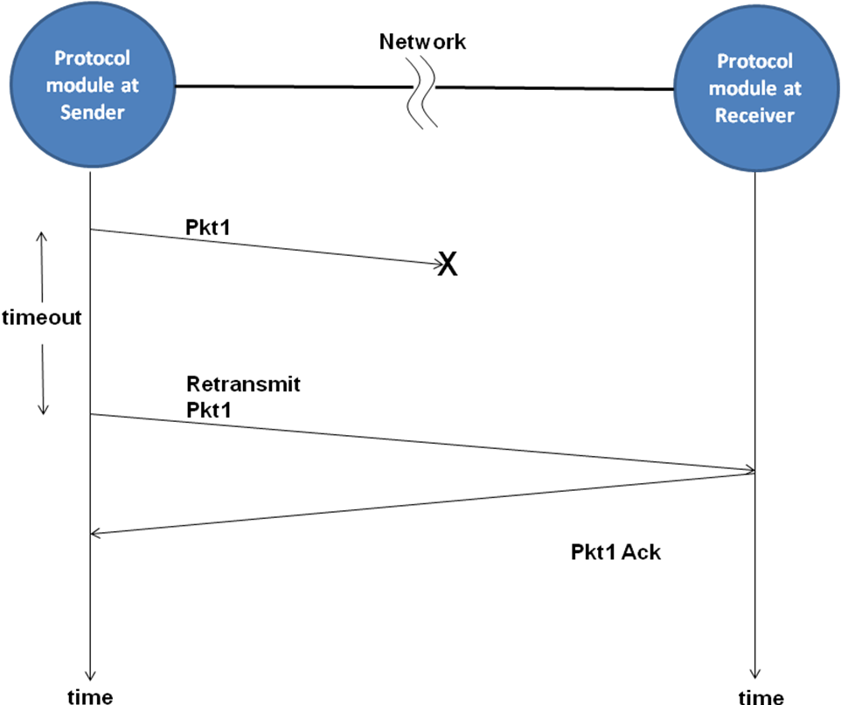
Lost packet

Slide 18
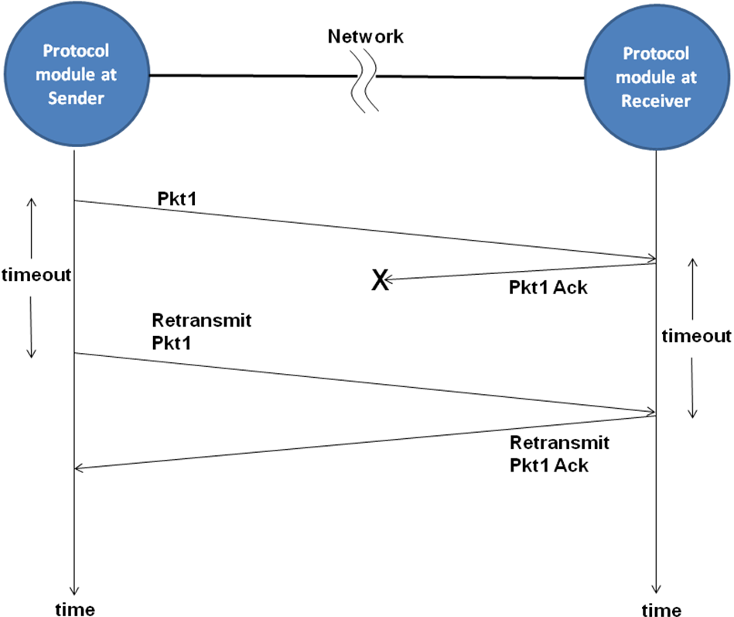
Lost ack

Slide 19
More details
How much buffer does the stack need at the sender?
Just 1
How much buffer does the stack need at the receiver?
Just 1
How do I know at the receiver that a packet I'm getting is not a duplicate
Include a sequence number
How big should a sequence number be?
It might only need to be 1 bit if there's only one message in flight

Slide 20
Assumptions
In our stop-and-wait protocol, we make some assumptions
Packet loss is possible
Packets don't get reordered or arbitrarily delayed (how can they if only one packet is in flight)
So we can get away with a 1 bit sequence number
However, there are more fundamental assumptions in a packet-switched network
Packet loss is possible (i.e. best-effort delivery)
Packets may be reordered or arbitrarily delayed
Packets may be damaged in transit
Our 1-bit sequence number isn't going to hold up with more than one packet in flight
So we use monotonically increasing sequence numbers

Slide 21
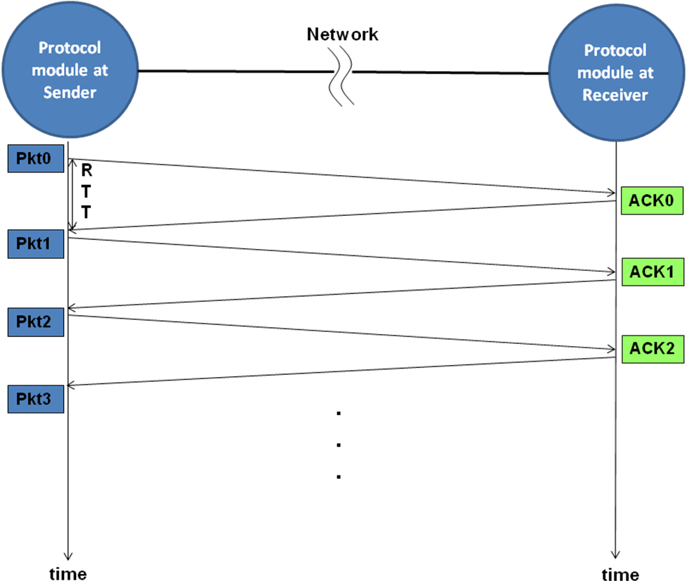
Working at top speed!
Remember Latency?
240 ms to Chennai
RTT = 240ms
4 packets per second throughput?
No matter how fast the network?

Slide 22
How many packet buffers does the sender need for stop-and-wait protocol?
1
2
Designer's choice
No way to predict in advance
Today’s number is 70476
10

Slide 23
Pipelined protocol
Pkt0
Pkt1
Pkt2
Pkt3
. . .
➔Blast a bunch of packets one after another
Timeline of sender
What could go wrong?

Slide 24
Reliable pipelined protocol
Sometimes all the packets don't make it the way!
We have to keep track

Slide 25
Reliable pipelined protocol
Pkt0
Pkt1
Pkt2
Pkt3
Ack0
Ack1
Ack2
Ack3
. . .
2τ
Pkt4
Pkt5
Pkt6
Pkt7
Now we get 4 packets every 240ms = 16 packets/sec
Timeline of sender

Slide 26
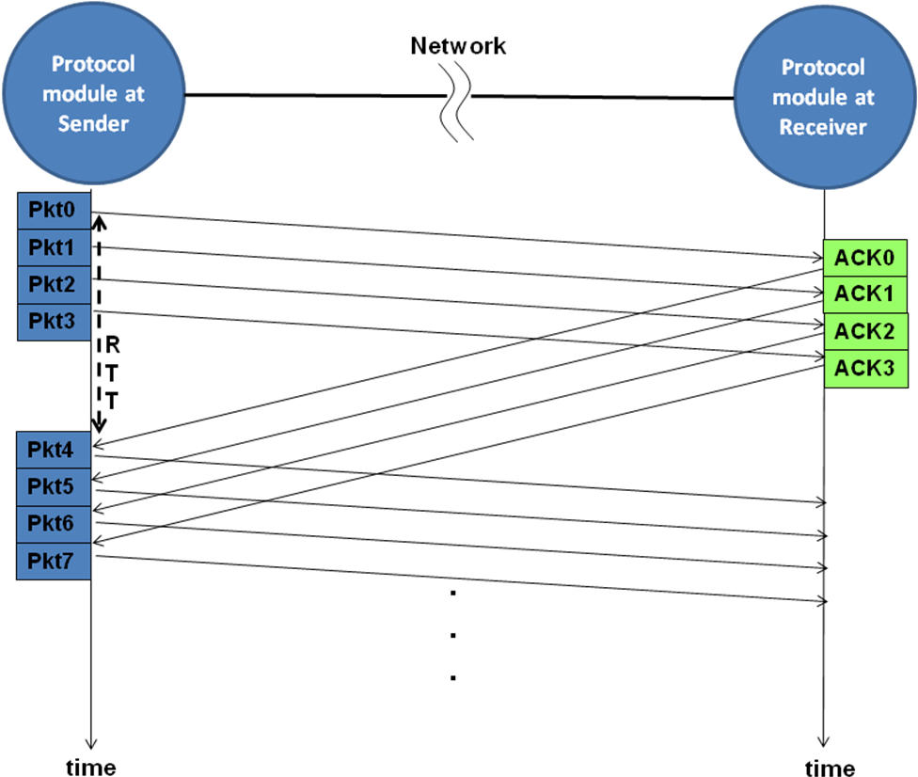
Reliable pipelined protocol
Buffers at sender
Buffers at receiver

Slide 27
How many?
How many packet buffers does the sender need to implement a reliable pipelined protocol?
1
2
One buffer for each packet in the pipeline
Protocol designer's choice
20

Slide 28
What might a packet look like?
struct header_t {
int destination_address; /* destination address */
int source_address; /* source address */
int num_packets; /* total number of packets in
the message */
int sequence_number; /* sequence number of this
packet */
int packet_size; /* size of data contained in
the packet */
int checksum; /* for integrity check of this
packet */
};
struct packet_t {
struct header_t header; /* packet header */
char *data; /* pointer to the memory buffer
containing the data of size
packet_size */
};

Slide 29
Transport (& session) layer concerns
Arbitrary message size
Out of order delivery
Packet loss
Bit errors
Queuing delays
How do we address these?

Slide 30
Transport (& session) layer concerns
Arbitrary message size
Out of order delivery
Packet loss
Bit errors
Queuing delays
➔ Big segments use multiple packets
➔ Sequence numbers
➔ Positive ACK and buffers
➔ Checksum for packet
➔ But how to handle this one?

Slide 31
Network congestion
10Gb/sec
10Gb/sec
100 Gb/sec
10Gb/sec
10Gb/sec
Access Networks
Regional networks
Networks tend to grow
Network connections get overcommitted
Packets are queued, but get so stale they must be dropped
Because of the sequence number, we can ignore heavily delayed packets if they ever make it

Slide 32
Reliable protocol with windowing
Increasing sequence numbers
Active window of
sequence numbers
Packets sent and acknowledged
Packets sent but not
yet acknowledged
Packets that are in the active
window that can
be sent without waiting for any
further ACKS
Packets that cannot yet
be sent since they
are outside the active window
Congratulations! You've now been introduced to TCP from the IPv4 protocol

Slide 33
Transport protocols on the Internet
Transport protocol | Features | Pros | Cons
TCP | Connection-oriented; self-regulating; data flow as stream; supports windowing and ACKs | Reliable; messages arrive in order; well-behaved due to self-policing | Complexity in connection setup and tear-down; at a disadvantage when mixed with unregulated flows; no guarantees on delay or transmission rate
UDP | Connection-less; unregulated; message as datagram; no ACKs or windowing | Simplicity; no frills; especially suited for environments with low chance of packet loss and applications tolerant to packet loss; | Unreliable; message may arrive out of order; may contribute to network congestion; no guarantees on delay or transmission rate

Slide 34
Choice of transport protocols
Application | Key requirement | Transport protocol
Web browser | Reliable messaging; in order arrival of messages | TCP
Instant messaging | Reliable messaging; in order arrival of messages | TCP
Voice over IP | Low latency | Usually UDP
Electronic Mail | Reliable messaging | TCP
Electronic file transfer | Reliable messaging; in order delivery | TCP
Video over Internet | Low latency | Usually UDP; may be TCP
File download on P2P networks | Reliable messaging; in order arrival of messages | TCP
Network file service on LAN | Reliable messaging; in order arrival of messages | TCP; or reliable messaging on top of UDP
Remote terminal access | Reliable messaging; in order arrival of messages | TCP

Slide 35
Now let's look lower
IP lives at the network layer
Let’s look specifically at IP as a layer 3 as well as its relationship to the Transport (Session) layers
OSI Model
Data
Layer
7
Data
Application
Network Process to Application
6
Data
Presentation
Data Representation
and Encryption
5
Data
Session
Interhost Communication
TCP/UDP
4
Segments
Transport
End-to-End Connections
and Reliability
3
Packets
Network
Path Determination
and IP (Logical Addressing)
IP
ARP
2
Frames
Data Link
MAC and LLC
(Physical addressing)
Ethernet
1
Bits
Physical
Media, Signal, and
Binary Transmission
1000baseSX

Slide 36

The Story of IP
No public internet
Islands of connectivity
Data link layer networks all over, even in 1983
Ethernet
802.11 wireless
Token Ring
AppleTalk
RS232 serial
ATM
And plenty more
So can we build a network of networks?

Slide 37
The Story of IP
Build a network layer that can address and interconnect all sorts of different data link networks
After a decade of innovation and another decade of growth
IP for everybody (version 4 that is) with two built-in transport protocols, TCP and UDP
The internet

Slide 38
IP datagram (packet) format
IP protocol version
number
32 bits
Total datagram
length (bytes)
Header length
(bytes/4)
ver
head.
len
type of
service
length
Used for
fragmentation/
reassembly
“Type” of data
flgs
fragment
offset
16-bit identifier
Max number
remaining hops
(decremented at
each router)
time to
live
upper
layer
header
checksum
32 bit source IP address
Upper layer protocol
to deliver payload to
32 bit destination IP address
options (if any)
e.g. timestamp,
record route
taken, specify
list of routers
to visit.
how much overhead?
20 bytes of TCP
20 bytes of IP
= 40 bytes + app layer overhead
data
(variable length,
typically a TCP
or UDP segment)

Slide 39
TCP Segment Header
Source port number
32 bits
Dest port number
Source port
Dest port
First byte number sent
Sequence number
Last byte
number received
Acknowledgement number (if ACK flag set)
Data
offs
CWR
ECE
URG
ACK
RST
FIN
NS
PSH
SYN
Window size
Size of sliding
window
000
Flags: NS CWR URG ECE
ACK PSH RST SYN FIN
Urgent ptr
Checksum
options (if any)
Last byte position
Of urgent data
(URG flag set)
data
(TCP payload)
Packet checksum

Slide 40
Visible relations between layers
Layers 2 through 5 are manifested in the packets we send on the network
(Layers 1, 6, and 7 are too, but showing them makes this too complicated)
Let’s see how…
OSI Model
Data
Layer
7
Data
Application
Network Process to Application
6
Data
Presentation
Data Representation
and Encryption
5
Data
Session
Interhost Communication
TCP/UDP
4
Segments
Transport
End-to-End Connections
and Reliability
3
Packets
Network
Path Determination
and IP (Logical Addressing)
IP
ARP
2
Frames
Data Link
MAC and LLC
(Physical addressing)
Ethernet
1
Bits
Physical
Media, Signal, and
Binary Transmission
1000baseSX

Slide 41
Encapsulated packets
Data Link
Ethernet (Layer 2) Header
-----------------
Ethernet Payload
-----------------
Ethernet Trailer
Ethernet (Layer 2) Header
-----------------
Ethernet Payload
-----------------
Ethernet Trailer
The network protocol is designed in layers
Thus, the lower level packets encapsulate (enclose) the higher level packets
Network
IP (Layer 3) Header
-----------------
IP Data
IP (Layer 3) Header
-----------------
IP Data
Transport/Session
TCP (Layer 4-5) Header
-----------------
TCP Payload
TCP (Layer 4-5) Header
-----------------
TCP Payload
Remember: Layer 2 doesn’t have to be ethernet and layer 4-5 doesn’t have to be TCP

Slide 42
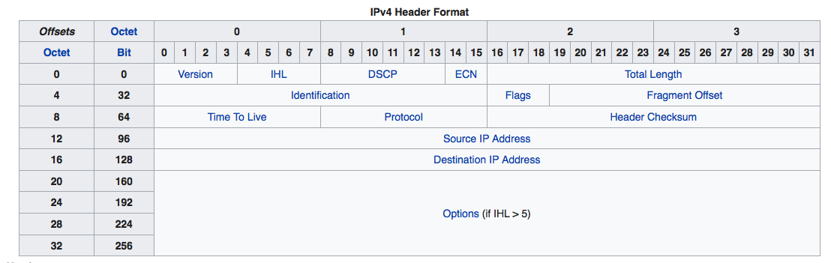
IPv4 Header

Slide 43
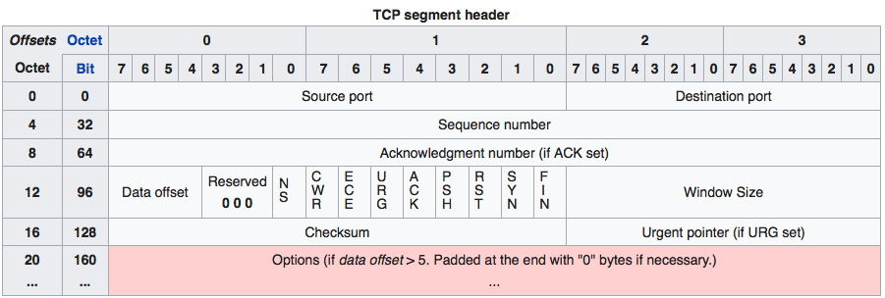
TCP Segment Header

Slide 44
IP Addressing
32 bits / 4 octets / four-decimal dotted quad
Did you know that 130.207.7.31 becomes 0x82CF071F?
Each of those four numbers is decimal for a single byte
And we need a mask
We use it to divide the IP address into a "network" part and a "host" part
It's a 32-bit number that starts with 1s and ends with 0s
The network part is "under" the ones in the mask
There are exactly 33 valid masks, FWIW

Slide 45
Subnet and CIDR Notation
Two different notations, same meaning:
130.207.254.64 255.255.255.192
130.207.254.64/26
In this example, the network part is the first 26 bits, host is last 6
If you're doing this every day, you learn to do it in your head; if not, use a subnet calculator, e.g. http://www.subnet-calculator.com/cidr.php
Cisco equipment sometimes uses the former notation; many other modern tools use the latter
130
207
254
64
1 1 0 0 1 1 1 1
10000010
11001111
11111110
01
000000
Note /26
leading 1 bits
1
2
8
6
4
3
2
1
6
8
4
2
1
255
255
255
192
11111111
11111111
11111111
11
000000
Network
Host
192 + 15 = 207
Notes:
45

Slide 46
What gets assigned an IP address?
Some people think that IP addresses are assigned to hosts (i.e. computers)
That’s a misconception
IP addresses are assigned to network interfaces, so a computer may have more than one.
To be able to participate on the internet, a computer just needs one network interface giving rise to the misconception that IP addresses are assigned to computers
Computers that route traffic between networks (a.k.a. routers) always have more than one IP address

Slide 47
What does it mean to be on the same network?
In the IP world, it’s simple
If network bits from two addresses are equal, the two are on the same network
“On the same network” means the data link layer will be used to deliver traffic between the two addresses, not the network layer
Source IP address | Destination IP address | Mask | On the same network?
130.207.7.23 | 130.207.254.16 | /16 (255.255.0.0) | Yes
192.168.1.2 | 192.168.2.2 | /24 (255.255.255.0) | No
0x81880507 | 0x818910F1 | /15 (255.254.0.0) | Yes
172.16.32.12 | 10.0.5.2 | /16 (255.255.0.0) | No

Slide 48
Are these two IP addresses on the same network?
143.215.14.243 and 143.214.14.242 if the mask for each is /24
Yes
No
Can’t tell
All of the above
Keeping the first 24 bits of the two addresses, we get
143.215.14.0
and
143.214.14.0
Are they the same number?
Nope.
30

Slide 49
Are these two IP addresses on the same network?
143.215.14.243 and 143.214.14.242 if the mask for each is /15
Yes
No
Can’t tell
None of the above
Keeping the first 15 bits of the two addresses, we get
143.214.0.0 (215=11010111₂; first 7 bits are 11010110₂)
and
143.214.0.0 (214=11010110₂; first 7 bits are 11010110₂)
Are they the same number?
Yes!
Today’s number is 12,861
40

Slide 50
Subnets
Remember those Islands of Connectivity? And that mask?
We call each of those “Islands” a subnet
The rule for IP routing:
If you’re on the same network, punt to the data link layer to deliver
Otherwise, use your IP routing table to forward it to another IP host on your network
How can you tell if you're on the same network?
The mask tells you how many leading bits are the “network part” of the IP address.
If the network part of the destination address matches the network part of (one of) your interface address(es), you’re on the same network.
Each node on the network only needs to know the mask for its own IP address (think about it), so masks don’t need to be passed in packets
So all hosts on a data link level network must be assigned IP addresses that have the same network part (and hence the same mask).

Slide 51
Connecting the Islands
Data link layer networks connected by IP hosts
Now where do the masks come in?
Clue: All the masks here are /24.
The blue blobs are indeed different IP networks
The three routers pass traffic between the three outer networks
223.1.1.2
223.1.1.4
223.1.1.1
223.1.1.3
223.1.9.2
223.1.7.2
223.1.9.1
223.1.7.1
223.1.8.1
223.1.8.0
223.1.2.6
223.1.3.27
223.1.2.1
223.1.2.2
223.1.3.1
223.1.3.2
Notes:
Need some examples

Slide 52
Traveling between the Islands
For example, 223.1.1.2 can talk to 223.1.3.2:
223.1.1.2 sends its packet for 223.1.3.2 to 223.1.1.3 via layer 2
The top router knows how it’s connected to the other two routers and so sends the packet from 223.1.1.2 to 223.1.7.1
The bottom right router knows it has a connection to 223.1.3.0/24 so it sends the packet from 223.1.1.2 to 223.1.3.2.
We’d say this route has “2 hops”
223.1.1.2
223.1.1.4
223.1.1.1
223.1.1.3
223.1.9.2
223.1.7.2
223.1.9.1
223.1.7.1
223.1.8.1
223.1.8.0
223.1.2.6
223.1.3.27
223.1.2.1
223.1.2.2
223.1.3.1
223.1.3.2
Notes:
Need some examples

Slide 53
IP Classes – History Lesson
In the dark ages, subnet masks could be derived from the network address
Now that’s called “classful” addressing
These can still show up as a default mask if you don't specify one
Class | Prefix | Range | Mask | Purpose
A | 0… | 0.0.0.0-127.255.255.255 | 8
B | 01… | 128.0.0.0-191.255.255.255 | 16
C | 011… | 192.0.0.0-223.255.255.255 | 24
D | 0111… | 224.0.0.0-239.255.255.255 | - | multicast
E | 1111… | 240.0.0.0-255.255.255.255 | - | reserved

Slide 54
CIDR: Classless Inter-Domain Routing
We ran out of IPv4 addresses in 1995!
This was the very clever solution
Turns out you only really need to know the network mask if you’re connected to that network!
Now we simply specify the mask for the local subnet on each network interface
Notes:
Special networks need to go later

Slide 55
IP Routing Table for an Edge Device
Destination | Gateway | Flags | Interface
0.0.0.0/0 | 128.61.5.1 | UG
128.61.5.0/24 | 0.0.0.0 | U | enp0s1
128.61.5.1/32 | 0.0.0.0 | U | enp0s1
127.0.0.1/8 | 127.0.0.1 | UH
If the destination is on our network, send the packet to the data link layer (Note this shows up in the routing table)
Look through the routing table and choose the match with the longest prefix (largest mask); send the packet to that gateway
Question: Which line does 128.61.5.82 match? How about 130.207.5.9? 127.87.5.12?
The interesting part comes later: How to create the routing table

Slide 56
Our Example Network
223.1.1.2
223.1.1.4
223.1.1.1
223.1.1.3
Let’s look at this router’s routing table
223.1.9.2
223.1.7.2
223.1.9.1
223.1.7.1
223.1.8.1
223.1.8.0
223.1.15.2
Internet
223.1.2.6
223.1.3.27
223.1.2.1
223.1.2.2
223.1.3.1
223.1.3.2
Notes:
Need some examples

Slide 57
IP Routing Table for a Router
Destination | Gateway | Flags | Interface
0.0.0.0/0 | 223.1.7.1 | UG
223.1.1.0/24 | 0.0.0.0 | U | enp2s1
223.1.7.0/24 | 0.0.0.0 | U | enp0s1
223.1.9.0/24 | 0.0.0.0 | U | enp1s1
223.1.2.0/24 | 223.1.9.1 | UG
223.1.3.0/24 | 223.1.7.1 | UG
223.1.7.1/32 | 0.0.0.0 | U | enp0s1
127.0.0.1/8 | 127.0.0.1 | UH
There is more than one possible set of values for this table, but this set is sufficient
How do you think this network shows up to the internet? 221.1.0.0/20 (e.g. 221.1.0 – 221.1.15.0)

Slide 58
Questions: IP Routing rules
If the network address part of the interface address and destination addresses are the same, then
Pass the packet to layer 2 for delivery
Send the packet to the next-hop router based on the IP routing table
Return an Acknowledgement to the source address
Send a Reset packet to the next-hop router
Today’s number is 12,861
50

Slide 59
Questions: IP Routing rules
If the network address part of the interface address and destination addresses are different, then
Pass the packet to layer 2 for delivery
Send the packet to the next-hop router by choosing the longest match in the IP routing table
Send the packet to the next-hop router by choosing the shortest match in the IP routing table
Return an ICMP “No route to host” message
60

Slide 60
Now let’s add Layers 4-5 in IP
TCP and UDP are the two most common IP Transport protocols
In IP, recall the division between L4 and L5 is not well defined
OSI Model
Data
Layer
7
Data
Application
Network Process to Application
6
Data
Presentation
Data Representation
and Encryption
5
Data
Session
Interhost Communication
TCP/UDP
4
Segments
Transport
End-to-End Connections
and Reliability
3
Packets
Network
Path Determination
and IP (Logical Addressing)
IP
ARP
2
Frames
Data Link
MAC and LLC
(Physical addressing)
Ethernet
1
Bits
Physical
Media, Signal, and
Binary Transmission
1000baseSX

Slide 61
Starting a TCP connection
TCP streams are always bidirectional. Either side may send data to the other side.
TCP uses a sequence number in each direction to maintain packet order
We refer to the 3 packets at the beginning of a TCP connection as the SYN, SYN-ACK, and ACK packets, hence the term 3-way handshake. SYN and ACK are flag bits in the TCP header.
This is the two sides exchanging (randomly chosen) sequence numbers to synchronize data going in both directions

Slide 62
Three-Way Handshake
The initiator (client) sends a packet with a random sequence number and the SYN flag set
The server recognizes the packet with SYN as a request to initiate a conversation. If it accepts the conversation, it responds by
putting the sequence number in the acknowledgment field
setting the ACK bit.
putting a different random sequence number in the packet
setting the SYN bit before sending the packet to the client
The client sees the SYN packet from the server and realizes that its request has been accepted. It responds with a packet containing the server’s sequence number in the acknowledgment field, the ACK bit set, and possibly some data in the payload.
When the client or server is done transmitting, it sends a packet with the FIN bit set. This causes the other side to no longer expect to receive packets on this connection

Slide 63
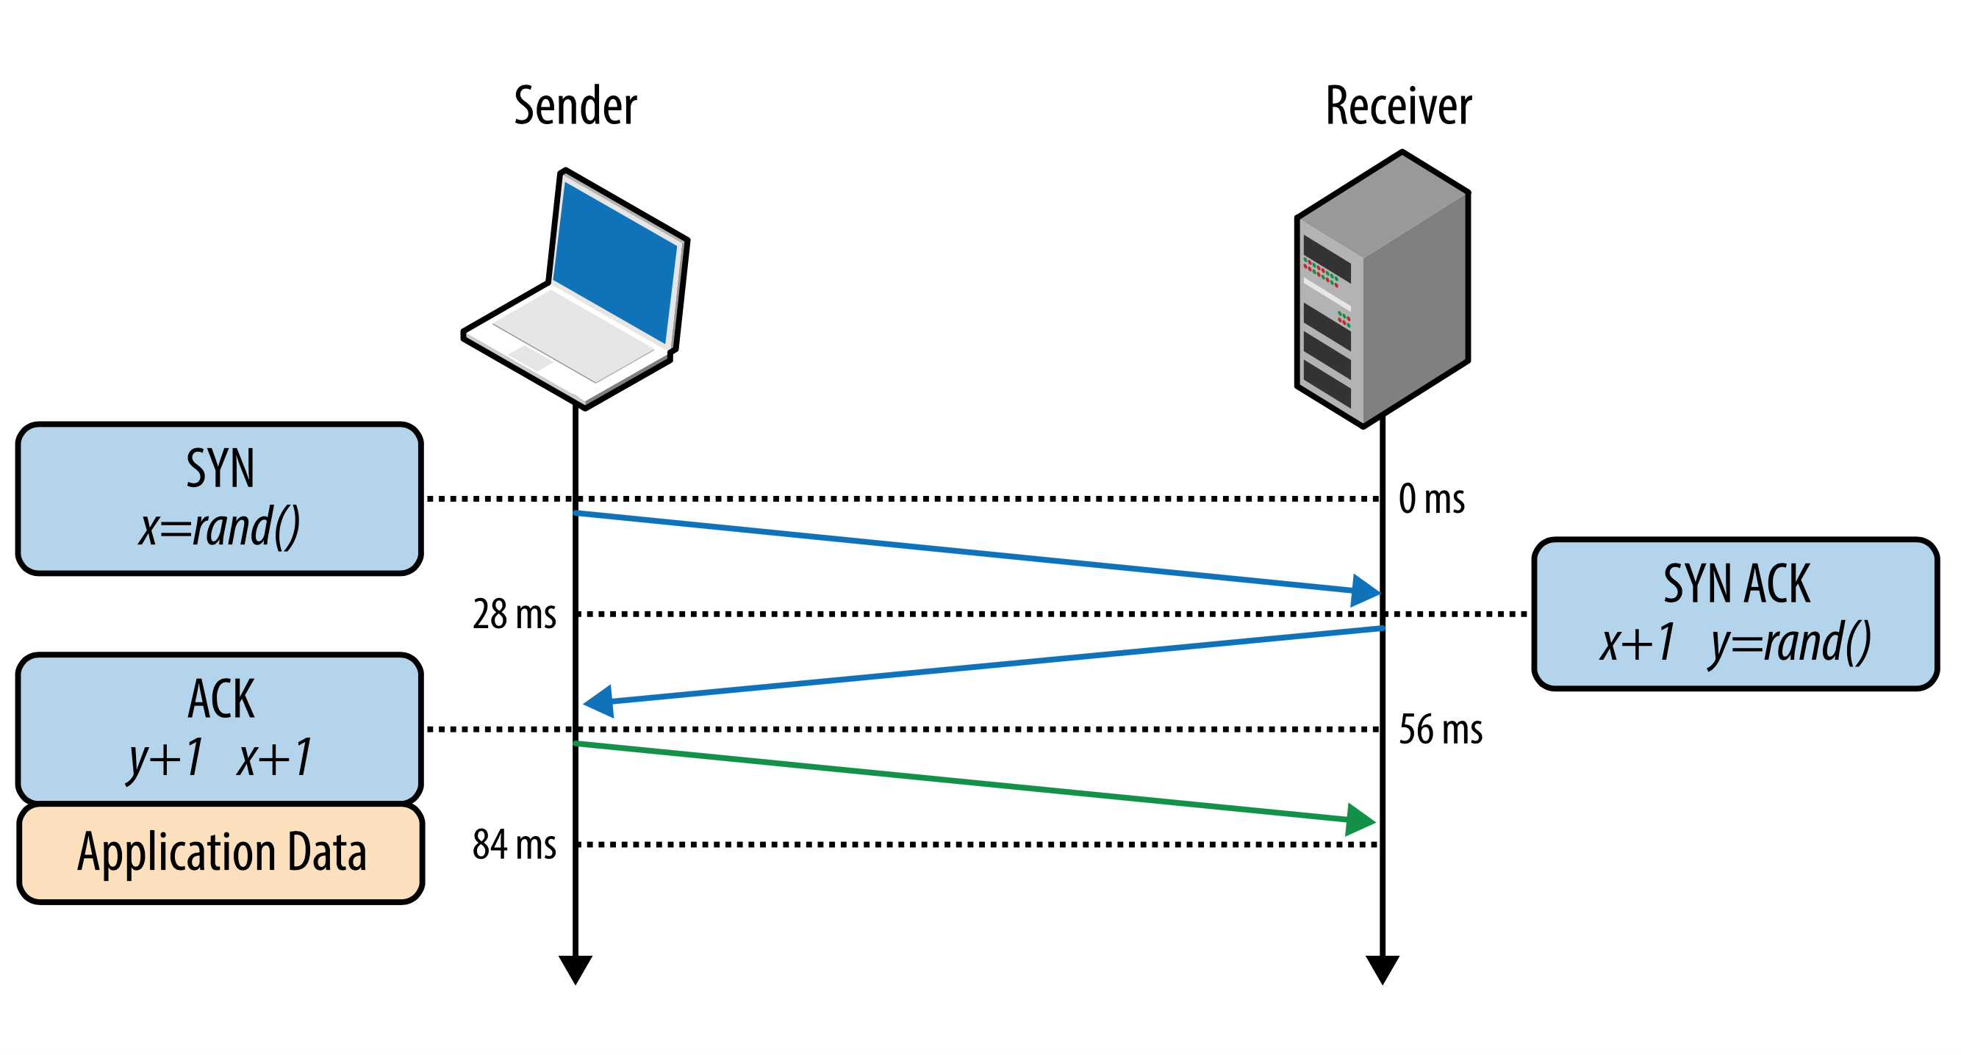
Three-way handshake in a picture

Slide 64
Ports and connection addressing
Source
IP
Source
Port
Destination
IP
Destination
Port
Rest of
the packet
We know how to get packets from one host to another, but how do we identify conversations?
How does one distinguish UDP and TCP traffic from different services that share the same network interface?
On each side of a conversation, port numbers (0-65535) are used to define unique connections
Often the destination port on the first packet is a Well-known or Registered port number
Note that the fields are not actually ordered this way in the packet
With TCP and UDP protocols, always consider the addressing as a quadruple: (source IP, source port, destination IP, destination port)
Trick question: How are ports used in ICMP conversations?
Let's look at where that ordered quad shows up in the segment...

Slide 65
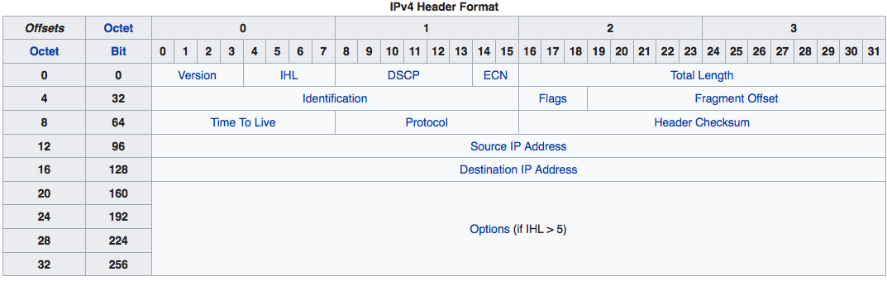
TCP (and UDP) port addressing

Slide 66
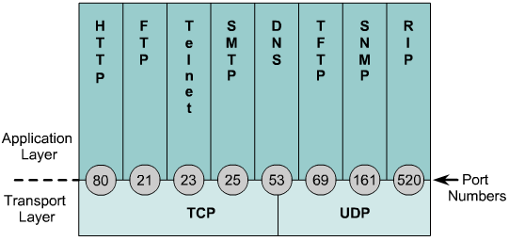
TCP and UDP port numbers
Port numbers are used to keep track of different conversations. Both source and destination port count.
Well-known ports numbers are traditionally from 1-1023.
Numbers 1024 and above are dynamic (ephemeral) port numbers.
Registered port numbers for vendor-specific applications are now allowed above 1024.

Slide 67
TCP and UDP port numbers
Destination ports are chosen based on the desired service
Often chosen based on the URL prefix, e.g. http: goes to 80, https: to 443
Source ports are usually chosen by the IP stack to be unique among all open connections
That makes the ordered quad unique among open connections
This is how we keep connections separate even though the IPs are the same

Slide 68
A browser opens two TCP connections to a web server
If the browser is running at 193.12.1.5, and the web server is offering service on port 80 at 130.207.7.13, how does TCP keep the conversations separate?
IP does this automatically
The conversations use independent sequence numbers to disambiguate them
The conversations include a special session-identifier that disambiguates them
The browser lets the TCP stack choose a unique source port number for each connection
Today’s number is 42,123
70

Slide 69
Conversations
When the web browser opens each connection, it doesn’t specify a source port, allowing the TCP stack to pick a source port that isn’t in use by any conversation on that host, say 31339 or 31337.
The TCP stack uses the quads (193.12.1.5, 31337 or 31339, 130.207.7.13, 80) and its reverse to distinguish the two separate conversations
Each connection gets its own sequence number, window size, etc. and is treated as a completely separate conversation by both the browser’s and the web server’s IP stacks
S:80
D:31339
Web
Server
Browser
S:31339
D:80
S:31337
D:80
S:80
D:31337
193.12.1.5
130.207.7.13

Slide 70
Stateful Firewalls
Follow a predefined policy on which ordered quads are allowed from which direction
Example: Allow no inbound packets; Allow all outbound packets
Records state on connections as it is opened
Requires a local state table (called a connection table)
Compares packets to the connection table first to automatically allow return traffic
Example: If (193.12.1.5, 31337, 130.207.7.13, 80) is put in the connection table, then return traffic from (130.207.7.13, 80, 192.12.1.5, 31337) is automatically allowed
Any inbound traffic to other ports at 192.13.1.5 is dropped since no policy rule allows it
Can do other protocol verification to drop malicious or badly-formed traffic
Makes sense if we don’t offer any services
Web
Server
Browser
S:31337
D:80
Inbound
Firewall
S:12384
D:80
193.12.1.5
S:80
D:31337
130.207.7.13
Connection
Table
Outbound
✓

Slide 71
Network Address Translation
Note there is confusing terminology
Types
Static one-to-one NAT
A mapping is configured so that source address or destination address is changed from/to the mapped address on transit; checksums are recalculated
Dynamic one-to-one NAT
Same as Static, but a public address from a pool isn’t mapped until a private address attempts to cross the NAT device; the public address is returned to the pool when the conversation ends
PAT or NPAT (network and port address translation)
Building on Dynamic NAT, both the source address and source port are mapped to an address and port from the public pool (often of size 1); return traffic is mapped by destination address and port.
And a lot of other variants
NPAT is typically the way we share a single public IP address among multiple hosts -- another way we’ve managed the scarcity of public IP addresses

Slide 72
Remote procedure call (RPC)
We create a higher-level abstraction that allows a client to call a procedure to run on another server
We simply replace the called function with a shim function that
Packs the arguments into a network packet
Sends the packet to the listener
Waits for a message from the listener with the function return value
Receives and unpacks the data into the function results value
Returns from the call with the result value
And the function's caller never knows that the work was done elsewhere!
P1
foo (args)
P2
foo (args)
RPC
return
Host 1
Host 2
The listener is a process in an infinite loop
It waits for message containing arguments
Unpacks the arguments
Calls the function with the arguments
Packs the result value into a network packet
Sends the packet back to the sender
Repeats the loop

Slide 73
NFS (Linux network file system)
Instead of making an I/O call to local storage, the file system passes the read() call through RPC to another Linux system
The "NFS server" fulfills the function call and sends the results back
User program
read()
read()
Linux file system
Linux file system
NFS client
NFS server
RPC layer at client
RPC layer at server
Network

Slide 74
IPv6
Goals
32-bit IPv4 address space was “used up” first about 1996 and then again in 2013…
…So bigger addresses!
More efficiently processed header
Header changes to facilitate QoS
Why such slow adoption?

Slide 75
Basic differences
Fixed-length 40 byte header
Options allowed after the header
No fragmentation allowed
No broadcast, only multicast
Addresses are 128 bits; network part is always the first 64 bits
1.8x10¹⁹ subnets; 1.8x10¹⁹ hosts on each subnet
Neighbor Discovery Protocol replaces ARP
NAT is discouraged, but local addresses available (fc00::/7)
Every interface must have a link-local address (fe80::/10)
Impractical to scan a subnet for hosts

Slide 76
IPv6 Addressing
Network
Interface Identifier (Host)
64 bits
64 bits
2610:0148:1F00:0000
0000:0000:0000:0001
128 bits
8 16-bit hex numbers separated by colons
A dual colon means fill in with zeroes; only one allowed
2610:0148:1F00:0000:0000:0000:0000:0001 can be written as 2610:148:1F00:0:0:0:1 or 2610:148:1F00::1

Slide 77
What is the size of an IPv6 address?
32 bits
64 bits
128 bits
256 bits
80

Slide 78
GT IPv6 Addressing Plan
2610
0148
Host
000uuuuu dddddddd
dddddddd dddddddd
u = major business unit, e.g 00=OIT, 01=GTRI, 02=CoE, 03=CoS, 04=CoC, 1F=reserved for legacy IPv4, 20-FF reserved for future
d = unit defined
00011111 ssssssss
xxxxxxxx yyyyyyyy
s = existing class B:
00=128.61.0.0
01=130.207.0.0
02=143.215.0.0
x.y = last two octets of IPv4 subnet address
So, for example, 128.61.5.0/24 is already assigned 2610:148:1f00:0500::/64
So far, only GTRI has fired up their non-legacy prefix

Slide 79
Now let's look at the data link layer
Ethernet is a very common data link network
OSI Model
Data
Layer
7
Data
Application
Network Process to Application
6
Data
Presentation
Data Representation
and Encryption
5
Data
Session
Interhost Communication
TCP/UDP
4
Segments
Transport
End-to-End Connections
and Reliability
3
Packets
Network
Path Determination
and IP (Logical Addressing)
IP
ARP
2
Frames
Data Link
MAC and LLC
(Physical addressing)
Ethernet
1
Bits
Physical
Media, Signal, and
Binary Transmission
1000baseSX

Slide 80
Let’s talk about Ethernet
Ethernet is a particular type of data link network
It was designed for relatively small areas, like a building, hence the term Local Area Network (LAN)
It has its very own standard (IEEE 802.3)
It’s evolved a great deal since the 1980s

Slide 81
Terminology
Collision domain - All the NICs that share a physical ethernet; only one can transmit at a time
Broadcast domain - All the NICs that can hear an ethernet broadcast frame
-----------
Repeater/hub - layer 1 replication/amplification of bits (both sides stay in one collision domain)
Bridge/switch - layer 2 re-transmission of ethernet frames (both sides stay in one broadcast domain)
Router - layer 3 forwarding of packets based on a layer-3 (IP) routing table
Host – a computer with one or more NICs; if it forwards traffic using multiple NICs, we’re going to call it a router, not a host.

Slide 82
Ethernet Addressing
Every ethernet device gets a unique burned-in MAC address
Organizationally Unique Identifier (OUI)
Network Interface Controller (NIC) Specific
0: unicast
1: multicast
6 bytes/48 bits
3 bytes OUI
3 bytes NIC specific
Examples
Apple: 00:25:00:f4:6d:c2
Oracle: 00-03-ba-a1-02-df
To identify the OUI
https://www.wireshark.org/tools/oui-lookup.html
0: globally unique (OUI)
1: locally administered

Slide 83
Ethernet Frames
Preamble
Destination MAC
Source MAC
802.1Q tag
Ether type/
Length
Payload
CRC
Interframe Gap
8
6
6
0-4
2
46-1500
4
12
To send a frame
Wait until no one using the cable (carrier sense)
Assert carrier signal on the cable
Broadcast the frame to all stations on the cable
If you detect a collision while transmitting, stop and requeue the frame for retransmission
If you hear a frame on the cable
Accept it if the destination MAC belongs to us (or if it has a broadcast or multicast destination MAC)
Drop it if you see a collision during its receipt or its CRC doesn't match
See where CSMA/CD term comes from?

Slide 84
Something is Missing…
Only one station can send at a time?
Where are the IP addresses?
We'll get back to this…

Slide 85
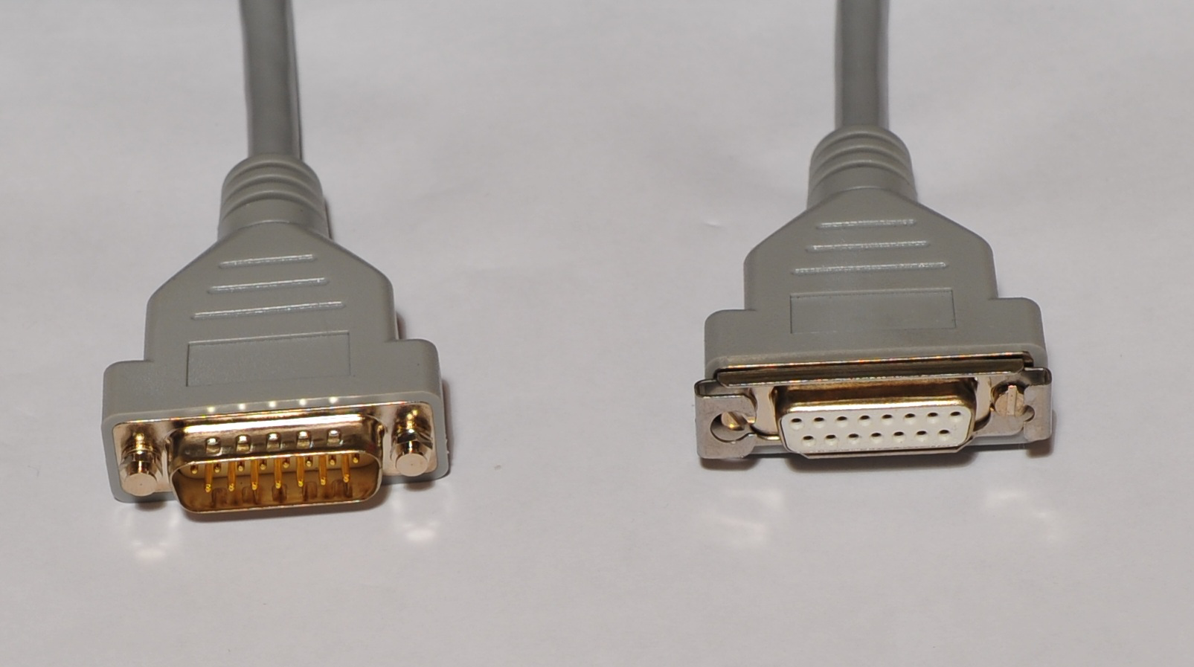
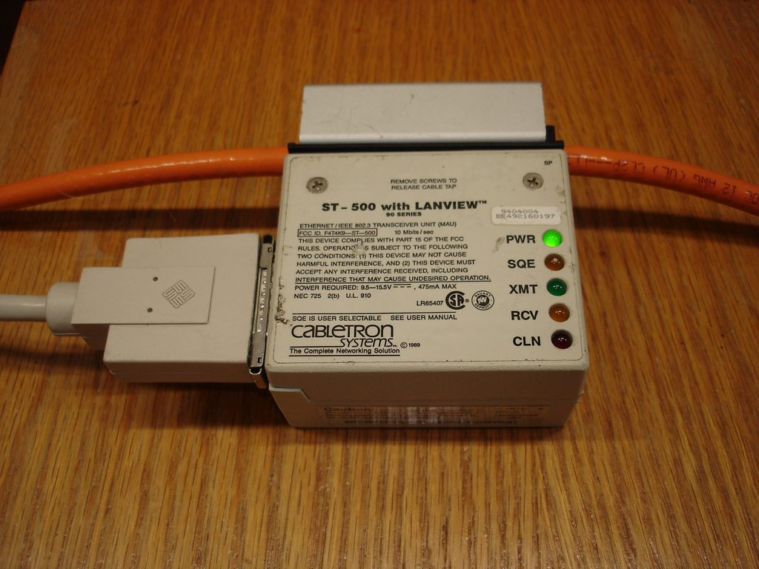
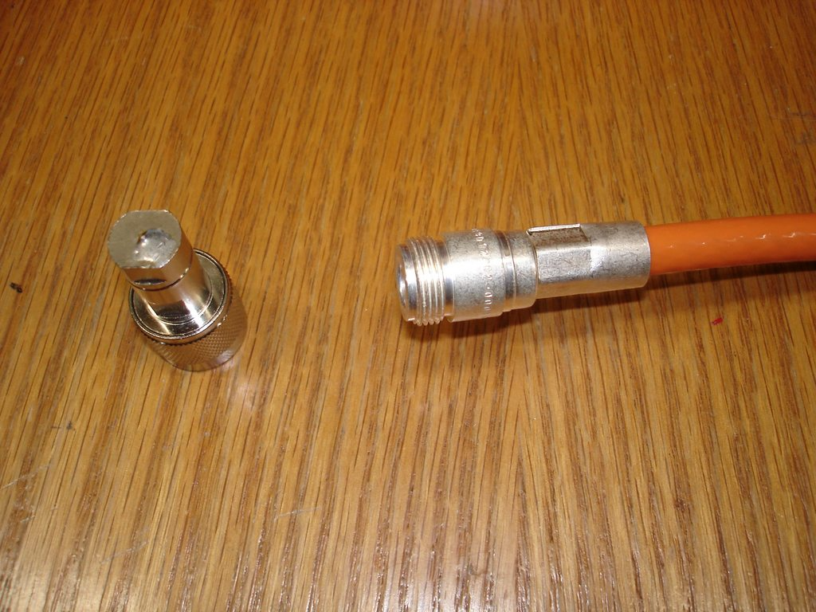
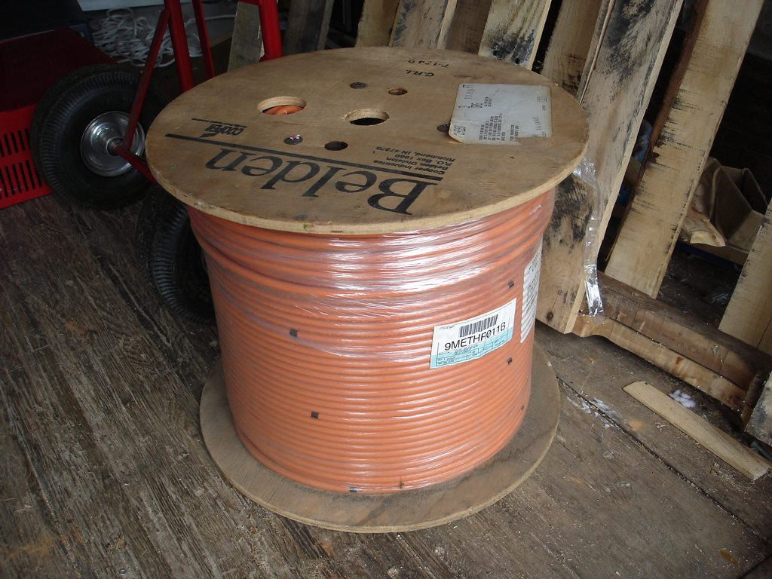
Ethernet Topology (some history)
Host
AUI cable
(14 wire)
Host
Host
Transceiver
Coaxial
(10base5)
cable
Terminator

Slide 86
Ethernet Topology (some history)
Broadcast Domain
Collision Domain
Collision Domain
Host
Cat 3/Cat 5
Twisted pair
cable
Host
Host
AUI cable
(14 wire)
Host
Collision
Domain
Host
Host
Host
Host
Host
Host
Collision
Domain
Host
Host
Host
Multi-port
Transceiver
Transceiver
Host
Collision
Domain
Host
Coaxial
(10base5)
cable
10baseT
Hub
10/100/1000baseT
Switch
Terminator
Adaptive
Bridge

Slide 87
Ethernet Topology (some history)
Broadcast Domain
Host
Cat 3/Cat 5
Twisted pair
cable
Collision
Domain
Host
Collision
Domain
Host
Collision
Domain
Collision
Domain
Host
Collision
Domain
Host
Host
Host
Collision
Domain
Host
Collision
Domain
Host
Collision
Domain
Host
Collision
Domain
Host
Host
Collision
Domain
Host
Collision
Domain
Host
Collision
Domain
Host
10/100/1000baseT
Switch
10/100/1000baseT
Switch
10/100/1000baseT
Switch
10/100/1000baseT
Switch

Slide 88
Ethernet Topology (a history)
Broadcast Domain
Host
Cat 3/Cat 5
Twisted pair
cable
Collision
Domain
Host
Collision
Domain
Host
Collision
Domain
Collision
Domain
Host
Collision
Domain
Host
Host
Host
Collision
Domain
Host
Collision
Domain
Host
Collision
Domain
Host
Collision
Domain
Host
Host
Collision
Domain
Host
Collision
Domain
Host
Collision
Domain
Host
10G/40G/100G
Switch
10G/40G/100G
Switch
10G/40G/100G
Switch
10G/40G/100G
Switch

Slide 89
Ethernet Bridging Algorithm (simplified)
Bridge Table
MAC Addr
Last Seen on Port
Last Used
002080 00324a
FastEthernet 1/4
12 sec ago
0003ba 51733a
FastEthernet 2/9
72 sec ago
. . .
. . .
. . .
When a frame enters the bridge (switch):
If the destination MAC address is in the bridge table
Send the frame out the port listed in the bridge table entry
Otherwise
Flood the frame out all ports except the ingress port
Put the source MAC address in the bridge table, if necessary, along with the frame ingress port and mark that entry “recently used”
Remove any “stale” entries in the bridge table

Slide 90
Something Is Still Missing
Now more than one message can be in transit at a time
But we've only talked about MAC addresses.
Where are the IP addresses?

Slide 91
Layer 3 (IP) packets
Preamble
Destination MAC
Source MAC
802.1Q tag
Ether type/
Length
Payload
CRC
Interframe Gap
8
6
6
0-4
2
46-1500
4
12
Source IP
Destination
IP
Zero
Protocol
Length
Data
4
4
1
1
2
38-1492
IP addresses appear in the Ethernet frame payload, not the header
But Ethernet hardware only examines the MAC addresses in the Ethernet frame(!)
How do we connect these two layers?

Slide 92
ARP
Address Resolution Protocol
Used with Ethernet to discover IP addresses
How?
IP stack needs to send to IP address a, but doesn’t know what destination MAC address to use.
Broadcast an ARP-request message: “Who has IP address a?”
Wait on unicast ARP-response: “I have IP address a.”
Store the response in a local ARP Table, discarding entries when they become stale.
Use the corresponding entry in the ARP table to set the destination MAC address of the frame.

Slide 93
ARP Table Example
% arp -anl
Neighbor Linklayer Address Expire(O) Expire(I) Netif Refs
192.168.0.69 f0:18:98:b:95:42 expired expired en0 1
192.168.0.79 4c:20:b8:a9:eb:80 1m21s 1m21s en0 1
192.168.0.84 e2:3c:4f:62:bd:11 8s 15s en0 1
192.168.0.85 ee:b3:0:a5:56:f1 32s 1m17s en0 1
192.168.0.87 14:7d:da:5a:c4:24 expired 2m2s en0 1
192.168.0.88 bc:d0:74:4e:88:98 expired 38s en0 1
192.168.0.92 24:f5:a2:ab:57:15 2m34s 2m34s en0 1
192.168.0.94 b8:27:eb:a:2b:15 expired expired en0 1
192.168.0.97 9c:50:d1:11:ca:a4 expired 1m59s en0 1
192.168.0.106 d6:7d:33:61:35:6a expired expired en0 2
192.168.0.109 24:f5:a2:ab:5e:b9 2m14s 2m14s en0 1
192.168.0.110 24:f5:a2:ab:5e:e1 2m18s 2m18s en0 1
192.168.0.111 f6:62:f6:80:d6:f1 56s 56s en0 1
192.168.0.113 ee:6a:e8:e6:67:cb 1m22s 1m29s en0 1
192.168.0.115 0:88:65:26:71:4b expired expired en0 1
192.168.0.118 8e:ab:c2:75:68:5b 41s 43s en0 1
192.168.0.127 ce:7c:cf:62:b0:3d expired expired en0 1
192.168.0.140 3c:7d:a:1:31:bc expired 56s en0 1
192.168.0.158 b6:68:3:e1:dc:39 expired expired en0 1
192.168.0.160 78:af:8:72:4c:37 expired 1m12s en0 1
192.168.0.163 d2:5e:70:43:c8:f6 expired expired en0 1
192.168.0.186 c2:2b:fd:ee:74:dc expired expired en0 1
192.168.0.254 d4:4:cd:4c:5f:f0 2m55s 2m55s en0 1

Slide 94
VLANs
Virtual LAN, a.k.a. VLAN
A group of hosts that can communicate as if they were attached to the same broadcast domain, regardless of their physical location.
A VLAN has the same attributes as a physical LAN, but it allows for hosts to be grouped together even if they are not connected to the same network switch.
Network reconfiguration can be done through software instead of physically relocating devices and wires.

Slide 95
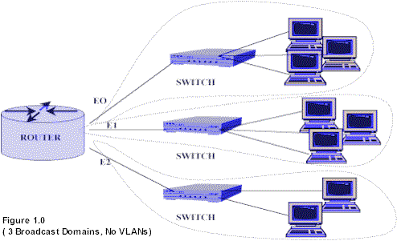
Geographic Addressing

Slide 96
After VLANs
Switch A
Each logical VLAN is like a separate physical bridge
College of Engineering (red)
College of Computing (black)
Classroom network (green)
Red
VLAN
Black
VLAN
Green
VLAN
Switch A - 1st floor
Switch B - 2nd floor
Each logical VLAN is like a separate physical bridge
VLANs can span across multiple switches
Red
VLAN
Black
VLAN
Green
VLAN
Red
VLAN
Black
VLAN
Green
VLAN

Slide 97
How Do They Do It?
Remember that optional 802.1q tag in the Ethernet frame?
We fill that with a VLAN number 1-4095, i.e. “tag the frame”.
Each edge port is labeled with a VLAN number
Switches
Tag each frame as it comes in
Segregate traffic carrying identical VLAN tags
Only output tagged traffic to edge ports carrying the same VLAN tag, removing the tags on egress
But that still doesn’t explain how switches communicate…

Slide 98
VLAN Trunks
Switch communicate via 802.1q “trunks” (sometimes called VLAN multiplexing)
Trunks are inter-switch links that simply preserve the VLAN tags on links between switches
Trunks can be configured to carry one, several, or all VLANs from one switch to another
Each VLAN in a trunk uses up switch resources so GT convention is that trunks are configured to only carry necessary VLANs

Slide 99
Trunking
Trunk
Trunk
Switch A - 1st floor
Switch B - 2nd floor
Red
VLAN
Black
VLAN
Green
VLAN
Red
VLAN
Black
VLAN
Green
VLAN
End result:
All the green ports appear in one broadcast domain (I.e. they appear to be on the same physical Ethernet)
The red ports appear on a different broadcast domain
And the black ports on a third broadcast domain
VLAN tags carried by ports and trunks are all configurable in software

Slide 100
Other VLAN Trivia
For computers to communicate on a VLAN
The switch has to be configured with the VLAN and the VLAN needs to be trunked between the switches that are to carry it.
Each edge port in the VLAN must be assigned to the VLAN.
Each must have an IP address and a subnet mask that is consistent for that VLAN. This is the same requirement as for a physically connected network.
Remember, just because two computers are physically connected to the same switch does not mean that they can communicate.
Devices on two separate networks must communicate via a router (Layer 3), whether or not VLANs are used.

Slide 101
Broadcast Mischief
Switch B - 2nd floor
Switch A - 1st floor
Red
VLAN
Black
VLAN
Green
VLAN
Switch C - 3rd floor
Broadcast
Red
VLAN
Black
VLAN
Green
VLAN
Red
VLAN
Black
VLAN
Green
VLAN
So what happens when someone sends a “broadcast” frame to one of our ports?

Slide 102
Making a Broadcast Storm
Switch B - 2nd floor
Switch A - 1st floor
Red
VLAN
Black
VLAN
Green
VLAN
Switch C - 3rd floor
Broadcast
Red
VLAN
Black
VLAN
Green
VLAN
Red
VLAN
Black
VLAN
Green
VLAN
Disaster! Every broadcast lives forever!
Loops are not healthy

Slide 103
Spanning Tree to the Rescue
So how do we get rid of loops?
Spanning tree protocol (simplified here)
Elect a root bridge (lowest priority, lowest MAC)
Cascade BPDU frames starting from the root
Based on the BPDUs they pass, each switch
Chooses the lowest cost route to the root bridge
Blocks any other ports that can get to the root
Recalculate when links change state

Slide 104
No More Loops
Switch B - 2nd floor
Switch A - 1st floor
Red
VLAN
Black
VLAN
Green
VLAN
Switch C - 3rd floor
Broadcast
Red
VLAN
Black
VLAN
Green
VLAN
Red
VLAN
Black
VLAN
Green
VLAN
Spanning tree blocks the link marked with an X.
Only one copy of the broadcast frame will make it to each red port.

Slide 105
Now let's look at the last layer
Ethernet standards allow use of several types of physical media
OSI Model
Data
Layer
7
Data
Application
Network Process to Application
6
Data
Presentation
Data Representation
and Encryption
5
Data
Session
Interhost Communication
TCP/UDP
4
Segments
Transport
End-to-End Connections
and Reliability
3
Packets
Network
Path Determination
and IP (Logical Addressing)
IP
ARP
2
Frames
Data Link
MAC and LLC
(Physical addressing)
Ethernet
1
Bits
Physical
Media, Signal, and
Binary Transmission
1000baseSX

Slide 106
Ethernet physical media standards
Twisted pair copper (1m – 100m reach)
10base-T 100base-T 1000base-TX – most common today 10Gbase-T
Fiber optic (100m – 40km reach)
1000base-SX, 1000base-LX 10Gbase-SR, 10Gbase-LR 40Gbase-SR4, 40Gbase-LR4 100Gbase-SR4, 100Gbase-SR10, 100Gbase-LR4 400Gbase-SR4, 400Gbase-LR4 800Gbase-SR8, 800Gbase-LR8 – in development and many more

Slide 107
Manchester encoding
0 1 1 0 0 1 0 1 1
Ethernet coax signaling uses Manchester encoding which is a scheme that guarantees at least one voltage transition during each clock tick

Slide 108
What’s in a Home Router?

Slide 109
Now let’s look above the top layer
Let’s look at the API used in Linux/Unix to access networks
OSI Model
Data
Layer
7
Data
Application
Network Process to Application
6
Data
Presentation
Data Representation
and Encryption
5
Data
Session
Interhost Communication
TCP/UDP
4
Segments
Transport
End-to-End Connections
and Reliability
3
Packets
Network
Path Determination
and IP (Logical Addressing)
IP
ARP
2
Frames
Data Link
MAC and LLC
(Physical addressing)
Ethernet
1
Bits
Physical
Media, Signal, and
Binary Transmission
1000baseSX

Slide 110
Network socket programming
Server
Client
The server sets up what's often known as a "listener" that's bound to a specific destination port
The client makes a "connect" request to the listener
The listener "accepts" the connection
Now the client and server can send data back and forth using send/recv (or write/read) system calls
socket()
socket()
setsockopt()
bind()
listen()
connect()
accept()
send()/recv()
send()/recv()

Slide 111
Example server
/* A simple server in the internet domain using TCP
The port number is passed as an argument */
#include <stdio.h>
#include <sys/types.h>
#include <sys/socket.h>
#include <netinet/in.h>
void error(char *msg)
{
perror(msg);
exit(1);
}
int main(int argc, char *argv[])
{
int sockfd, newsockfd, portno, clilen;
char buffer[256];
struct sockaddr_in serv_addr, cli_addr;
int n;
if (argc < 2) {
fprintf(stderr,"ERROR, no port provided\n");
exit(1);
}
sockfd = socket(AF_INET, SOCK_STREAM, 0);
if (sockfd < 0)
error("ERROR opening socket");
bzero((char *) &serv_addr, sizeof(serv_addr));
portno = atoi(argv[1]);
serv_addr.sin_family = AF_INET;
serv_addr.sin_addr.s_addr = INADDR_ANY;
serv_addr.sin_port = htons(portno);
if (bind(sockfd, (struct sockaddr *) &serv_addr,
sizeof(serv_addr)) < 0)
error("ERROR on binding");
listen(sockfd,5);
clilen = sizeof(cli_addr);
newsockfd = accept(sockfd, (struct sockaddr *) &cli_addr, &clilen);
if (newsockfd < 0)
error("ERROR on accept");
bzero(buffer,256);
n = read(newsockfd,buffer,255);
if (n < 0) error("ERROR reading from socket");
printf("Here is the message: %s\n",buffer);
n = write(newsockfd,"I got your message",18);
if (n < 0) error("ERROR writing to socket");
return 0;
}

Slide 112
Example client
/* A simple client in the internet domain using TCP
The server and port number are passed as arguments */
#include <stdio.h>
#include <sys/types.h>
#include <sys/socket.h>
#include <netinet/in.h>
#include <netdb.h>
void error(char *msg) {
perror(msg);
exit(0);
}
int main(int argc, char *argv[]) {
int sockfd, portno, n;
struct sockaddr_in serv_addr;
struct hostent *server;
char buffer[256];
if (argc < 3) {
fprintf(stderr,"usage %s hostname port\n", argv[0]);
exit(0);
}
portno = atoi(argv[2]);
sockfd = socket(AF_INET, SOCK_STREAM, 0);
if (sockfd < 0)
error("ERROR opening socket");
server = gethostbyname(argv[1]);
if (server == NULL)
error("ERROR, no such host");
bzero((char *) &serv_addr, sizeof(serv_addr));
serv_addr.sin_family = AF_INET;
bcopy((char *)server->h_addr,
(char *)&serv_addr.sin_addr.s_addr,
server->h_length);
serv_addr.sin_port = htons(portno);
if (connect(sockfd,(struct sockaddr *)&serv_addr, sizeof(serv_addr)) < 0)
error("ERROR connecting");
printf("Please enter the message: ");
bzero(buffer,256);
fgets(buffer,255,stdin);
n = write(sockfd,buffer,strlen(buffer));
if (n < 0) error("ERROR writing to socket");
bzero(buffer,256);
n = read(sockfd,buffer,255);
if (n < 0) error("ERROR reading from socket");
printf("%s\n",buffer);
return 0;
}
Source: https://www.cs.rpi.edu/~moorthy/Courses/os98/Pgms/client.c

Slide 113
Performance metrics
Transmission time or end-to-end latency = S+T_{W}+T_{f}+R
Message throughput = message-size/end-to-end-latency
What determines T_{w}?
How long it takes to put the message on the network?
T_{w} = message-size/network-bandwidth
Ex: 21MB at 56Kb/sec
(21 * 2²⁰ * 8) / 56000
3146 seconds
P1
P2
Processing overhead at sender
Protocol
stack
Protocol
stack
R
S
msg
Processing overhead at receiver
pkt1
pkt2
…
pktn
Network
T_{w}
T_{f}
Flight time
Wire delay

Slide 114
Performance metrics
Transmission time or end-to-end latency = S+T_{W}+T_{f}+R
Message throughput = message-size/end-to-end-latency
P1
What determines T_{f}?
Basically the speed of light in the transmission medium (~0.5c to 1c)
How far is it from P1 to P2?
Queuing delay is an additional term
P2
Processing overhead at sender
Protocol
stack
Protocol
stack
R
S
msg
Processing overhead at receiver
pkt1
pkt2
…
pktn
Network
T_{w}
T_{f}
Flight time
Wire delay

Slide 115
Performance metrics
Transmission time or end-to-end latency = S+T_{W}+T_{f}+R
Message throughput = message-size/end-to-end-latency
P1
What determines S & R?
The OS implementation of the protocol stack
P2
Processing overhead at sender
Protocol
stack
Protocol
stack
R
S
msg
Processing overhead at receiver
pkt1
pkt2
…
pktn
Network
T_{w}
T_{f}
Flight time
Wire delay

Slide 116
Timeline example
100ms latency
10 packets
Window size = 5
Wire delay (data) = 0.5ms
Wire delay (ack) = ~0
Receiver & Sender overhead = ~0
Timeline of sender
Pkt0
Pkt1
Pkt2
Pkt3
Pkt4
Ack0
Ack1
Ack2
Ack3
Ack4
100 + 100 ms
0.5 ms
0 ms
Pkt5
Pkt6
Pkt7
Pkt8
Pkt9
Ack5
Ack6
Ack7
Ack8
Ack9
100 + 100 ms
0.5 ms
0 ms
4 * 0.5 ms
Total time for the transmission to complete
End-to-end latency for Pkt0
= S + T_{w} + T_{f} + R
0 + 0.5 + 100 + 0
100.5 ms
Total transmission time
= 0.5 + 100 + 100 + 0 + 0.5 + 100 + 100 + 0.5 + 0.5 + 0.5 + 0.5
0.5 + 200 + 0.5 + 200 + 4 * 0.5
402.5 ms
End-to-end latency for Ack0
= S + T_{w} + T_{f} + R
0 + 0.0 + 100 + 0
100.0 ms

Slide 117
Timeline example
100ms latency
10 packets
Window size = 5
Wire delay (data) = 0.5ms
Wire delay (ack) = ~0
Receiver & Sender overhead = ~0
Timeline of sender
Pkt0
Pkt1
Pkt2
Pkt3
Pkt4
Ack0
Ack1
Ack2
Ack3
Ack4
100 + 100 ms
0.5 ms
0 ms
Pkt5
Pkt6
Pkt7
Pkt8
Pkt9
Ack5
Ack6
Ack7
Ack8
Ack9
100 + 100 ms
0.5 ms
0 ms
4 * 0.5 ms
Total time for the transmission to complete
End-to-end latency for Pkt0
= S + T_{w} + T_{f} + R
0 + 0.5 + 100 + 0
100.5 ms
Total transmission time
= 0.5 + 100 + 100 + 0 + 0.5 + 100 + 100 + 0 + 0.5 + 0.5 + 0.5 + 0.5
0.5 + 200 + 0.5 + 200 + 4 * 0.5
403 ms
End-to-end latency for Ack0
= S + T_{w} + T_{f} + R
0 + 0.0 + 100 + 0
100.0 ms

Slide 118
In the expression S + T_{w} + T_{f} + R
What does T_{W} stand for?
T_{w} = window-size
T_{w} = message-size / network-bandwidth
T_{w} = distance-between-endpoints / 0.5 c
T_{w} = sender-overhead + receiver-overhead
None of the above
Today’s number is 10,000
120

Slide 119
Acknowledgement example
Example
A transport protocol uses a window of 10 packets.
For a message that consists of 101 packets, how many acknowledgement packets does the destination generate?
Assume no packets are lost.
101

Slide 120
Packets and payloads
What is the maximum size of the payload in an ICMP ECHO packet, given ethernet packet size of 1500 bytes and header size of 28 bytes?
1528 bytes
1472 bytes
1500 bytes
Cannot be determined with data given
Default ethernet max payload = 1500 bytes
IP header = 20 bytes
ICMP header = 8 bytes
1500-20-8 = 1472 bytes
130

Slide 121
Back to the network layer
Why are we back here?
Recall, IP routing happens here
We didn’t answer a question.
How does a router know where to route (i.e. who sets up the routing table)?
OSI Model
Data
Layer
7
Data
Application
Network Process to Application
6
Data
Presentation
Data Representation
and Encryption
5
Data
Session
Interhost Communication
TCP/UDP
4
Segments
Transport
End-to-End Connections
and Reliability
3
Packets
Network
Path Determination
and IP (Logical Addressing)
IP
ARP
2
Frames
Data Link
MAC and LLC
(Physical addressing)
Ethernet
1
Bits
Physical
Media, Signal, and
Binary Transmission
1000baseSX

Slide 122
router
router

Slide 123
Network layer
Routing information protocols
Link state protocols
Distance vector protocols
Hierarchical routing
Addressing

Slide 124
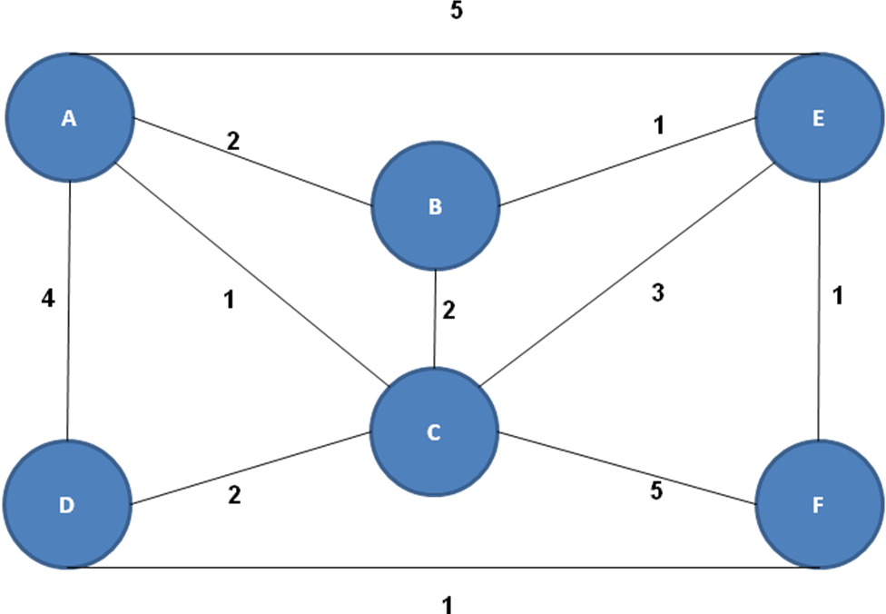
Intuition behind routing algorithms (link state, distance vector)
What's the latency to get to your neighbor?

Slide 125
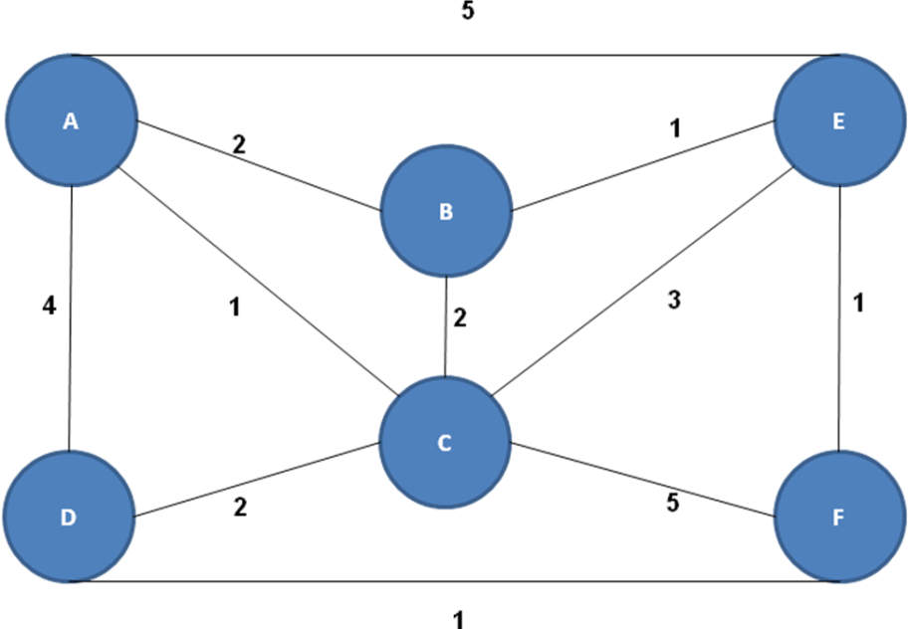
Distance vector in action
Uses neighbor info, local algorithm (i.e. every node only sees its neighbors)
Each node knows the cost to each of its neighbors
Each node sends its idea of routing to each of its neighbors
Known colloquially as ”routing by rumor”
For every other node, each node determines the lowest cost next-hop
Algorithm runs simultaneously on every node
How does it work?
Node E knows its costs to its neighbors:
Routes from E | A | B | C | D | F
Cost/next hop | 5/A | 1/B | 3/C | ∞/ | 1/F

Slide 126
Distance vector in action
Node E listens to messages from its neighbors:
A says its routes are 0/A, 5/E, 2/B, 1/C, 4/D, 4/F
B says its routes are 0/B, 1/E, 2/C, 2/A, 5/F, 4/D
C says its routes are 0/C, 1/A, 2/D, 5/F, 3/E, 2/B
F says its routes are 0/F, 5/C, 1/D, 1/E, 2/B, 4/A
D isn't heard because it isn't connected to E
Node E looks at each route from each neighbor N; it adds its cost to get to N to N's cost to get to each other node.
For each node, if the sum is lower cost than what E has in its route table, E changes its own route to run through the neighbor
Routes from E | A | B | C | D | F
Cost/next hop | 5/A | 1/B | 3/C | ∞/ | 1/F
Reviewing node A's message
5+2/B, 5+1/C, 5+4/D, 5+4/F
Only 9/D is less
We'll set the next hop to A

Slide 127
Distance vector in action
Node E listens to messages from its neighbors:
A says its routes are 0/A, 5/E, 2/B, 1/C, 4/D, 4/F
B says its routes are 0/B, 1/E, 2/C, 2/A, 5/F, 4/D
C says its routes are 0/C, 1/A, 2/D, 5/F, 3/E, 2/B
F says its routes are 0/F, 5/C, 1/D, 1/E, 2/B, 4/A
D isn't heard because it isn't connected to E
Node E looks at each route from each neighbor N; it adds its cost to get to N to N's cost to get to each other node.
For each node, if the sum is lower cost than what E has in its route table, E changes its own route to run through the neighbor
Routes from E | A | B | C | D | F
Cost/next hop | 5/A | 1/B | 3/C | 9/A | 1/F
Reviewing Node B's message
1+2/C, 1+2/A, 1+5/F, 1+4/D
3/A and 5/D are lower cost
We set their next hop to B

Slide 128
Distance vector in action
Node E listens to messages from its neighbors:
A says its routes are 0/A, 5/E, 2/B, 1/C, 4/D, 4/F
B says its routes are 0/B, 1/E, 2/C, 2/A, 5/F, 4/D
C says its routes are 0/C, 1/A, 2/D, 5/F, 3/E, 2/B
F says its routes are 0/F, 5/C, 1/D, 1/E, 2/B, 4/A
D isn't heard because it isn't connected to E
Node E looks at each route from each neighbor N; it adds its cost to get to N to N's cost to get to each other node.
For each node, if the sum is lower cost than what E has in its route table, E changes its own route to run through the neighbor
Routes from E | A | B | C | D | F
Cost/next hop | 3/B | 1/B | 3/C | 5/B | 1/F
Reviewing Node C's message
3+1/A, 3+2/D, 3+5/F, 3+2/B
None are lower cost

Slide 129
Distance vector in action
Node E listens to messages from its neighbors:
A says its routes are 0/A, 5/E, 2/B, 1/C, 4/D, 4/F
B says its routes are 0/B, 1/E, 2/C, 2/A, 5/F, 4/D
C says its routes are 0/C, 1/A, 2/D, 5/F, 3/E, 2/B
F says its routes are 0/F, 5/C, 1/D, 1/E, 2/B, 4/A
D isn't heard because it isn't connected to E
Node E looks at each route from each neighbor N; it adds its cost to get to N to N's cost to get to each other node.
For each node, if the sum is lower cost than what E has in its route table, E changes its own route to run through the neighbor
Routes from E | A | B | C | D | F
Cost/next hop | 3/B | 1/B | 3/C | 5/B | 1/F
Reviewing Node F's message
1+5C, 1+1/D, 1+2/B, 1+4/A
2/D is lower cost
We'll set the next hop to F

Slide 130
Distance vector in action
Node E listens to messages from its neighbors:
A says its routes are 0/A, 5/E, 2/B, 1/C, 4/D, 4/F
B says its routes are 0/B, 1/E, 2/C, 2/A, 5/F, 4/D
C says its routes are 0/C, 1/A, 2/D, 5/F, 3/E, 2/B
F says its routes are 0/F, 5/C, 1/D, 1/E, 2/B, 4/A
D isn't heard because it isn't connected to E
Node E looks at each route from each neighbor N; it adds its cost to get to N to N's cost to get to each other node.
For each node, if the sum is lower cost than what E has in its route table, E changes its own route to run through the neighbor
Routes from E | A | B | C | D | F
Cost/next hop | 3/B | 1/B | 3/C | 2/F | 1/F
Do you agree that E now knows the next hop for the lowest cost routes to the other nodes?
This of course presumed the other nodes knew their lowest cost routes
When this runs on all nodes simultaneously, they will converge on this solution in a relatively short time

Slide 131
Distance Vector vs Link State
Distance Vector
Each node knows the cost to reach each of its neighbors
Each node sends its routing table to only its neighbors
Each node revises its own routing table every time it receives a routing table from a neighbor
Link State
Each node advertises its neighbor links and costs to every other node in the network
Each node collects the entire topology of the network from these advertisements
Using a “shortest path” algorithm, each node calculates its own routing table

Slide 132
Link state in action
Dijkstra's shortest path algorithm
Uses global info, local algorithm (i.e. every node has this graph)
n-1 iterations
One least-cost route to a destination
Runs simultaneously on each node
Iteration Count | Nodes to which least-cost routes known | B Cost/ route | C Cost/ route | D cost/ route | E Cost/ route | F Cost/ route
Init | A | 2/AB | 1/AC | 4/AD | 5/AE | ∞
1
2
3
4
5
Calculating on Node A
(each node does its own calculation)

Slide 133
Link state in action
Dijkstra's shortest path algorithm
Uses global info, local algorithm (i.e. every node has this graph)
n-1 iterations
One least-cost route to a destination
Runs simultaneously on each node
Iteration Count | Nodes to which least-cost routes known | B Cost/ route | C Cost/ route | D cost/ route | E Cost/ route | F Cost/ route
Init | A | 2/AB | 1/AC | 4/AD | 5/AE | ∞
1 | A,C | 2/AB | 1/AC | 3/ACD | 4/ACE | 6/ACF
2
3
4
5
Calculating on Node A
(each node does its own calculation)

Slide 134
Link state in action
Dijkstra's shortest path algorithm
Uses global info, local algorithm (i.e. every node has this graph)
n-1 iterations
One least-cost route to a destination
Runs simultaneously on each node
Iteration Count | Nodes to which least-cost routes known | B Cost/ route | C Cost/ route | D cost/ route | E Cost/ route | F Cost/ route
Init | A | 2/AB | 1/AC | 4/AD | 5/AE | ∞
1 | A,C | 2/AB | 1/AC | 3/ACD | 4/ACE | 6/ACF
2 | A,C,B | 2/AB | - | 3/ACD | 3/ABE | 6/ACF
3
4
5
Calculating on Node A
(each node does its own calculation)

Slide 135
Link state in action
Dijkstra's shortest path algorithm
Uses global info, local algorithm (i.e. every node has this graph)
n-1 iterations
One least-cost route to a destination
Runs simultaneously on each node
Iteration Count | Nodes to which least-cost routes known | B Cost/ route | C Cost/ route | D cost/ route | E Cost/ route | F Cost/ route
Init | A | 2/AB | 1/AC | 4/AD | 5/AE | ∞
1 | A,C | 2/AB | 1/AC | 3/ACD | 4/ACE | 6/ACF
2 | A,C,B | 2/AB | - | 3/ACD | 3/ABE | 6/ACF
3 | A,C,B,D | - | - | 3/ACD | 3/ABE | 4/ACDF
4
5
Calculating on Node A
(each node does its own calculation)

Slide 136
Link state in action
Dijkstra's shortest path algorithm
Uses global info, local algorithm (i.e. every node has this graph)
n-1 iterations
One least-cost route to a destination
Runs simultaneously on each node
Iteration Count | Nodes to which least-cost routes known | B Cost/ route | C Cost/ route | D cost/ route | E Cost/ route | F Cost/ route
Init | A | 2/AB | 1/AC | 4/AD | 5/AE | ∞
1 | A,C | 2/AB | 1/AC | 3/ACD | 4/ACE | 6/ACF
2 | A,C,B | 2/AB | - | 3/ACD | 3/ABE | 6/ACF
3 | A,C,B,D | - | - | 3/ACD | 3/ABE | 4/ACDF
4 | A,C,B,D,E | - | - | - | 3/ABE | 4/ACDF
5 | A,C,B,D,E,F | - | - | - | - | 4/ACDF
Calculating on Node A
(each node does its own calculation)

Slide 137
A host using link state routing protocol
Knows only about the routes of its neighbors
Knows the topology of the entire local network
Uses a breadth-first search to calculate distances to other hosts
Uses less CPU time than a distance vector protocol host would
140

Slide 138
Hierarchical routing algorithms
Network of networks
Very large scale, frequent state changes
Compartmentalize so routing information protocol issues don't spread and cause widespread outages
What better example than the Internet itself!
Autonomous Systems (AS)
It is a collection of IP routing prefixes under the control of common administrative policy that presents a common, clearly defined routing policy to the internet.
Gateway nodes connect to other AS gateway nodes for inter-AS routing

Slide 139
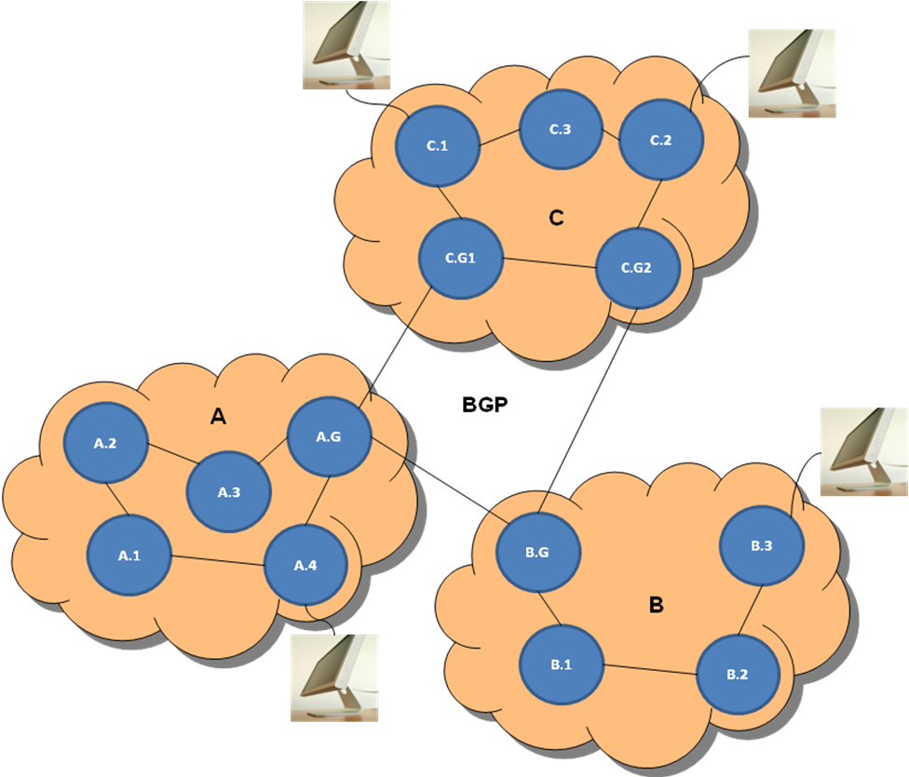
Hierarchical routing algorithms
Gateway nodes use BGP to interconnect Autonomous Systems
Nodes within an AS use LS or DV or some other routing protocol
We use BGP as the internet inter-AS routing protocol
ASs are assigned numbers by IANA/ARIN
Nodes within an AS use LS or DV (or other) routing protocol

Slide 140
Border Gateway Protocol (BGP)
BGP is a path-vector protocol. (We’re not going into much detail about that.)
The gateway routers send path-vector messages to advertise the reachability of networks.
Each router that receives a path vector message must verify the advertised path according to its policy.
If the message is compliant, the router modifies its routing table and the message before sending the message to the next neighbor.
It modifies the routing table to maintain the autonomous systems that are traversed in order to reach the destination system.
It modifies the message to add its AS number and to replace the next router entry with its identification.

Slide 141
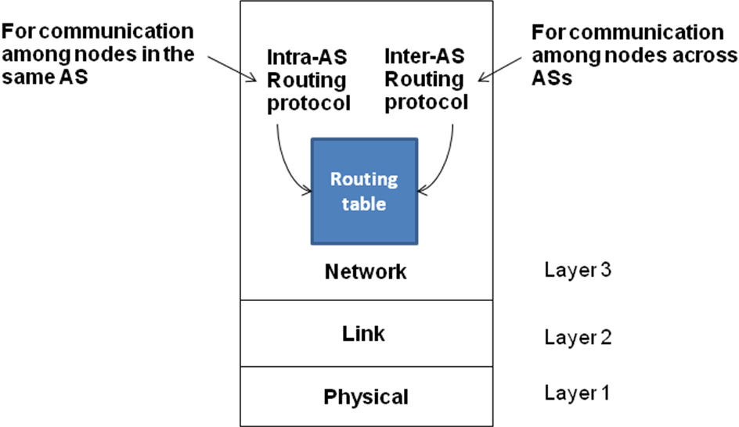
Routing at GT
The GT campus network is AS 2367
There are two Juniper routers that function as Gateway Routers and run BGP
The rest of the campus network runs OSPF (a link-state protocol)

Slide 142
Remember this slide?
Now consider an email from Joe to his grandmother
Yuba City, CA
Atlanta
Sacramento
Atlanta
So just where is this so-called “core”

Slide 143
There really is no internet core …
Instead there are dozens of Internet Exchange Points (IXPs) where groups of Internet Service Providers (ISPs) interconnect their networks

Slide 144
There really is no internet core …
The ISPs peer using BGP such that all the gateway routers know multiple routes to every regional ISP
You can begin to see that the Internet has a highly distributed ”core” created by multiple IXPs
There are at least four IXPs in Atlanta; GT participates in and operates an ISP, SoX, which provides network access for about 3 dozen southeastern universities and research centers
The diagram on the next page shows just the IXPs in which SoX participates. Note that traffic is allowed to traverse SoX networks to get from one ISP to another.
The diagram doesn’t show the SoX peering with other entities such as Google, AT&T, NASA, Dept of Energy, and Comcast

Slide 145
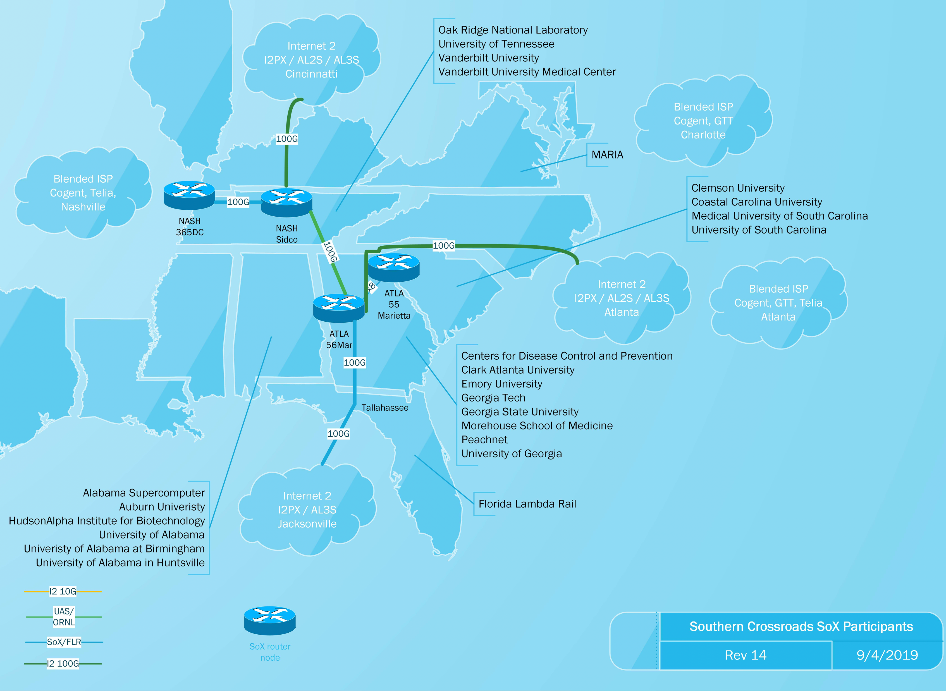

Slide 146
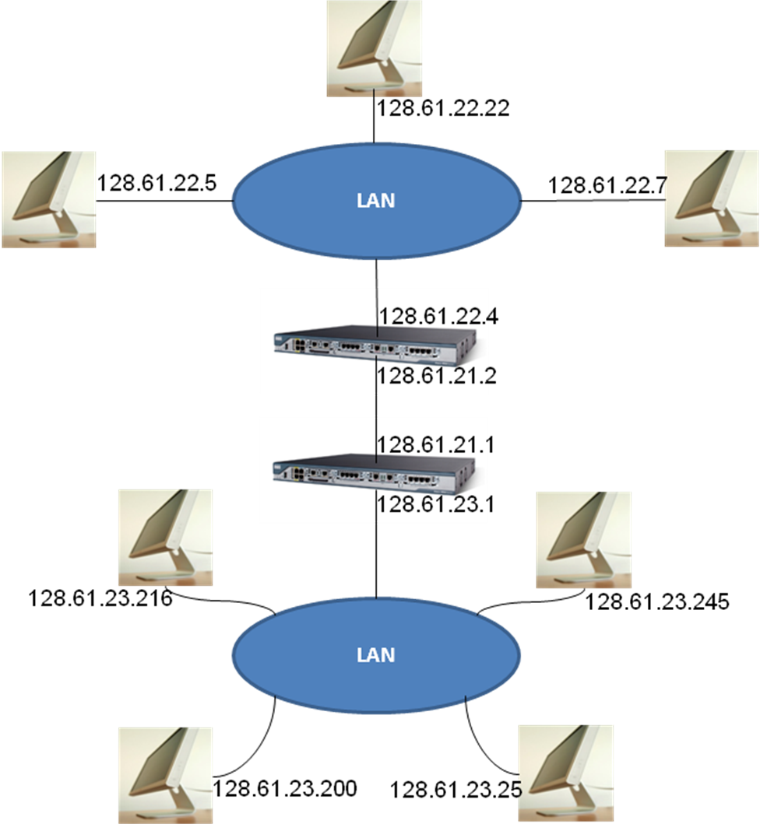
Reviewing Internet Addressing
Recall IP addressing
A network part
A host part
What do we need to tell how many networks are in this diagram?
We need a mask of course
If you know that the mask is /24 or 255.255.255.0, how many IP networks are present?
There are three with the network numbers 128.61.22.0/24, 128.61.21.0/24, and 128.61.23.0/24

Slide 147
Where is the core of the internet located?
Washington, DC
Stanford University, Palo Alto, CA
Columbia University, New York City
Salt Lake City, UT
Not any one place
150

Slide 148
Network Layer Summary
Network Terminology | Definition/Use
Circuit switching | A network layer technology used in telephony. Reserves the network resources (link bandwidth in all the links from source to destination) for the duration of the call; no queuing or store-and-forward delays
Packet switching | A network layer technology used in wide area Internet. It supports best effort delivery of packets from source to destination without reserving any network resources en route.
Message switching | Similar to packet switching but at the granularity of the whole message (at the transport level) instead of packets.
Switch/Router | A device that supports the network layer functionality. It may simply be a computer with a number of network interfaces and adequate memory to serve as input and output buffers.
Input buffers | These are buffers associated with each input link to a switch for assembling incoming packets.
Output buffers | These are buffers associated with each outgoing link from a switch if in case the link is busy.
Routing table | This is table that gives the next hop to be used by this switch for an incoming packet based on the destination address. The initial contents of the table as well as periodic updates are a result of routing algorithms in use by the network layer.

Slide 149
Network Layer Summary
Network Terminology | Definition/Use
Delays | The delays experienced by packets in a packet-switched network
Store and forward | This delay is due to the waiting time for the packet to be fully formed in the input buffer before the switch can act on it.
Queuing | This delay accounts for the waiting time experienced by a packet on either the input or the output buffer before it is finally sent out on an outgoing link.
Packet loss | This is due to the switch having to drop a packet due to either the input or the output buffer being full and is indicative of traffic congestion on specific routes of the network.
Service Model | This is the contract between the network layer and the upper layers of the protocol stack. Both the datagram and virtual circuit models used in packet-switched networks provide best effort delivery of packets.
Virtual Circuit (VC) | This model sets up a virtual circuit between the source and destination so that individual packets may simply use this number instead of the destination address. This also helps to simplify the routing decision a switch has to make on an incoming packet. (ATM and X.25)
Datagram | This model does not need any call setup or tear down. Each packet is independent of the others and the switch provides a best effort service model to deliver it to the ultimate destination using information in its routing table. (IP)

Slide 150
Summary
Data
Layer
Sockets, http
RPC
TCP
TCP
IP
Ethernet
Wired, wireless hardware
7
Data
Application
Network Process to Application
6
Data
Presentation
Data Representation
and Encryption
5
Data
Session
Interhost Communication
4
Segments
Transport
End-to-End Connections
and Reliability
3
Packets
Network
Path Determination
and IP (Logical Addressing)
2
Frames
Data Link
MAC and LLC
(Physical addressing)
1
Bits
Physical
Media, Signal, and
Binary Transmission

Slide 151
A brief history of electronic communication
You won't be responsible for the following slides, but you may find them interesting
Wikipedia is a great place to look for more detail on these events
Credit goes to Prof. Kishore Ramachandran for providing them

Slide 152
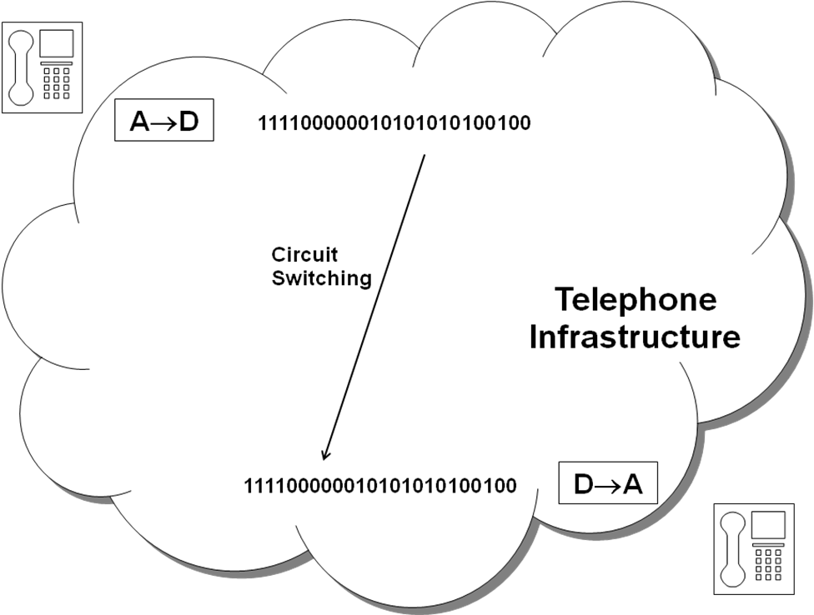
From Telephony to Computer Networking
1875 Telephone invented…analog system
1960 Telephone infrastructure goes digital

Slide 153
From Telephony to Computer Networking
1940's Mainframe computers developed
1960's Transition
Batch-oriented card-input/output
CRT I/O and timesharing

Slide 154
From Telephony to Computer Networking

Slide 155
From Telephony to Computer Networking
Short for Modulator/Demodulator
EXTRA!!!!!
1960 AT&T
INTRODUCES
DATAPHONE
First Commercial
Modem!

Slide 156
From Telephony to Computer Networking
1968/9 Carterphone decision allowed devices which were beneficial and not harmful to the network to be connected to the Public Switched Telephone Network (PSTN).
Allowed non-Bell system equipment to be connected and paved the way for computers to communicate using the telephone switching infrastructure.

Slide 157
Evolution of the Internet
1965 DoD DARPA plans first computer network
1969 ARPANET connects 4 computers using packet switched network
Stanford Research Institute, UCLA, UC Santa Barbara, and the University of Utah
Networking luminary Leonard Kleinrock, is credited with successfully sending the first network "message" from UCLA to Stanford.

Slide 158
Evolution of the Internet
"Router" in the network was called Interface Message Processor (IMP), built by a company called BBN (which stands for Bolt, Beranak, and Newman Inc.).
IMP system architecture required a careful balance of the hardware and software that would allow it to be used as a store-and-forward packet switch among these computers.
IMP's used modems and leased telephone lines to connect to one another.
1971 The ARPANET grows to 23 hosts connecting universities and government research centers around the country.

Slide 159
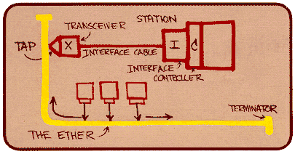
Evolution of the Internet
1973 Robert Metcalfe and David Boggs invent the Ethernet networking system at the Xerox Palo Alto Research Center.

Slide 160
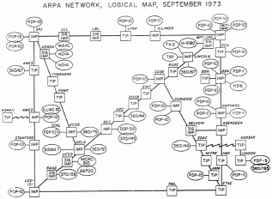
Evolution of the Internet
1973 The ARPANET goes international

Slide 161
Evolution of the Internet
1975 Internet operations transferred to the Defense Communications Agency
1978 Hayes Microcomputer Products releases the first mass-market modem, transmitting at 300 bps (0.3K).
1980 John Shoch at Xerox creates the first "worm" program, with the capacity to travel through networks.
1981 Ungermann-Bass ships the first commercial Ethernet network interface card.

Slide 162
Evolution of the Internet
1981 ARPANET has 213 hosts. A new host is added approximately once every 20 days.
1982 The term 'Internet' is used for the first time.
1983 TCP/IP becomes the universal language of the Internet. Developed by Vinton Cerf and Robert Kahn
1984 CISCO founded
Early 80's Unix and IBM OS included TCP/IP

Slide 163
Evolution of the Internet
Late 90's Internet becomes household term
Needed PC
Needed "Killer app" i.e. WWW & browsers

Slide 164
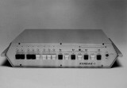
PC and the arrival of LAN
1971 Intel introduces the first microprocessor - the Intel 4004.
1971 The Kenbak-1, the first microcomputer, is introduced in Scientific American, selling a total of 40 units in 2 years.
Used 130 IC's with a 256 byte memory and 8-bit words, processed 1000 instructions per second, and cost $750.

Slide 165
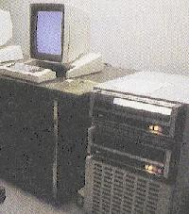
PC and the arrival of LAN
1972 Intel launches the 8-bit 8008 - the first microprocessor which could handle both upper and lowercase characters.
1972 Xerox develops the Xerox Alto - the first computer to use a Graphic User Interface.
The Alto consists of four major parts: the graphics display, the keyboard, the graphics mouse, and the disk storage/processor box. Each Alto is housed in a beautifully formed, textured beige metal cabinet that hints at its $32,000 price tag (1979US money). With the exception of the disk storage/processor box, everything is designed to sit on a desk or tabletop

Slide 166
PC and the arrival of LAN
1974 Intel introduces the 8080 microprocessor
5 times faster than the 8008.
And the heart of the future Altair 8800.
1975 MITS markets the Altair 8800 - the first mass-market microcomputer, launching the Personal Computer Revolution.
1975 Bill Gates and Paul Allen form the Microsoft company to create software for the new Altair 8800.

Slide 167
PC and the arrival of LAN
1976 Apple Computer is formed by Steve Jobs, Steve Wozniak, and Ron Wayne, and launches the Apple Computer.
1977 Tandy Radio Shack ships its first personal computer - the TRS-80. It sells over 10,000 units, tripling expectations.
1977 Apple Computer launches the Apple II, which sets new standards for sophisticated personal computer systems.

Slide 168
PC and the arrival of LAN
1978 The C programming language is completed at AT&T Bell Laboratories, offering a new level of programming.
1978 Apple and Tandy ship PCs with 5.25" floppy disks, replacing cassette tape as the standard storage medium for PCs.
1978 Hayes Microcomputer Products releases the first mass-market modem, transmitting at 300 bps (0.3K).

Slide 169
PC and the arrival of LAN
1978 Intel ships the Intel 8086 microprocessor, with 29,000 transistors, and running at 4.77 megahertz.
1979 Personal Software creates VisiCalc for the Apple II, the first electronic spreadsheet program, selling over 100,000 copies.
1979 Intel develops the 8088 microprocessor, which would later become the heart of the IBM PC.

Slide 170
PC and the arrival of LAN
1979 Motorola develops the Motorola 68000 microprocessor, offering a new level of processing power.
1979 Robert Metcalf founded 3COM
1980 Seagate Technology introduces the first microcomputer hard disk, capable of holding 5 megabytes of data.
1980 Philips introduces the first optical laser disk, with many times the storage capacity of floppy or hard disks.

Slide 171
PC and the arrival of LAN
1980 Xerox creates Smalltalk - the first object-oriented programming language.
1981 Ungermann-Bass ships the first commercial Ethernet network interface card.
1981 Xerox introduces the Xerox Star 8010, the first commercial Graphic User Interface computer, for $16,000-$17,000.

Slide 172
PC and the arrival of LAN
1981 Microsoft supplies IBM with PC-DOS (which it would also sell as MS-DOS), the OS that would power the IBM PC.
1981 IBM brings to market the IBM PC, immediately establishing a new standard for the world of personal computers.

Slide 173
Evolution of LAN
Thicknet
Coaxial cable/Vampire taps
10base5 (10 Mbits/sec, baseband, 500 meters)
1979-1985

Slide 174
Evolution of LAN
Thinnet
Coaxial cable/BNC connectors
10base2 (10 Mbits/sec, baseband, 200 meters)
1985-1993

Slide 175
Evolution of LAN
Fast Ethernet
Move "ethernet" into the box
100baseT (T for twisted pair)
RJ45 Connectors

